Slide 1
Employment claim process and Personal safety
Thursday 14 July 2022
Wendy Anderson and Trudy Downes
Notes:
Welcome to the MCNZ webinar series. This webinar...Employment claim process and Persona
Recording this webinar & relevant info on website
Q&A– post as you think, answered at the end of each speaker with exception of questions we will be answering as we talk
Background and what we do
WA – been managing P&I for over 5 yrs @ MCNZ
Background in insurance and investigations
TD - -is the H&S Advisor for MCNZ, been with MCNZ since 2017
Background in government compliance which leads to today’s topic of getting our evacuation plans approved
PRESENTATIONS

Slide 2
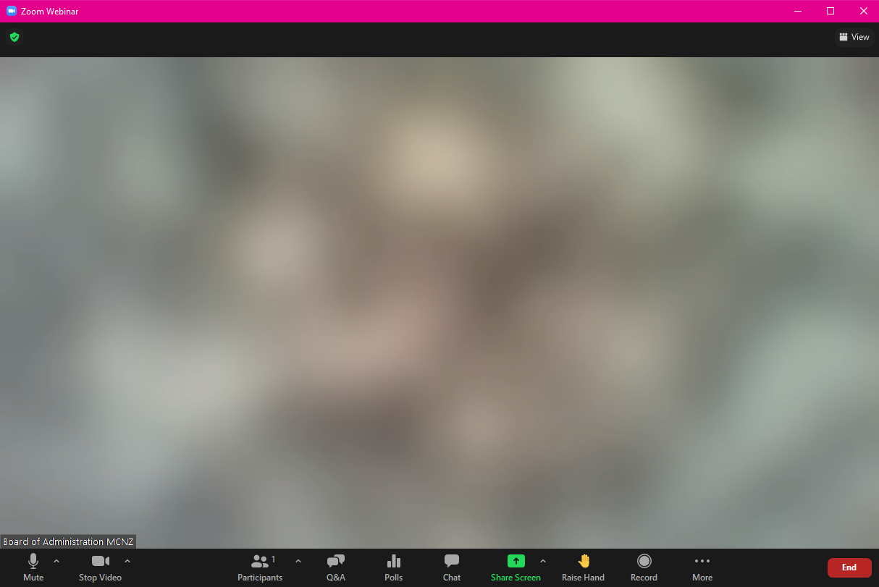
Questions
Notes:
Use the Q&A option at the bottom of your screen
Post your questions as you think of them
Questions will be answered as each speaker finishes

Slide 3
Employment Claims
Examples:
An employee claims a Personal Grievance
There is an employment dispute
Somebody wants to change the current employment arrangements

Slide 4
What can trigger an employment claim
Changes in employment circumstances
Unaddressed work conditions (may also bring a prosecution)
Seek legal advice for changes in employment conditions, especially to establish consultation process
Notes:
A claim can be triggered from a change in circumstances not being handled correctly. eg
Organisational restructure
Potential redundancies
Disciplinary process
Employment termination
Cancellation of funding
Unaddressed work conditions can also trigger an employment claim. Unaddressed work conditions include: physical aspects like abuse/assault, mental/pyschosocial [bullying, managerial pressure], biological hazards)
I cannot stress enough how important it is to seek legal advice for changes in employment conditions.

Slide 5
The notification process
Consultation processes have legal advice
Potential Claim
Notify Connexional Office
Insurer notified
Seek preferred legal advice
Insurer to determine
Notes:
A potential claim is triggered, notify the Connexional office as soon as possible.
Notifying the Connexional Office doesn’t cost anything if there isn’t a claim but all legal advice will incur costs. What might cost you $10k may save you $50k
There is a $30k excess if an insurance claim proceeds.

Slide 6
Employment Liability Insurance
Personal grievances following dismissal of staff
Personal grievances following managerial ‘misadventure’
Mitigating Risk, involve the Connexional Office
Personal grievance settlements
$30k excess

Slide 7
Relevant insurance covers
Employment disputes liability
Employers liability
Professional indemnity
Statutory liability
Directors and Officers Liability (for board members)
Medical malpractice
Notes:
(List only as relates to employment disputes/PG scenarios.)
Directors and Officers Liability (Side A & B) To cover directors, executives and employees against liability they might incur in carrying out the duties of a company director. The insurance can also reimburse the company where it has already indemnified its directors for any such liability. Cover can include associated defence costs.
Employment Disputes Liability To cover damages and costs arising out of certain employment related disputes such as wrongful termination, harassment and discrimination. Cover includes associated defence costs.
Professional Indemnity and / or Errors & Omissions To cover legal liability incurred by giving negligent advice or through a breach of professional duty. Cover includes associated defence costs.
Statutory Liability To cover fines or penalties imposed for unintentional breaches of certain statutes. Cover includes associated defence costs.
Employers Liability Covers claims made by employees against employers for injury or illness occurring in the workplace where cover falls outside the scope of accident compensation legislation. Cover includes associated defence costs
Medical Malpractice
Covers claims from third parties arising from an allegation of a Medical Incident in the conduct of Professional Healthcare Services provided that arises from an act, error or omission. Cover includes associated defence costs.

Slide 8
Personal Safety
Visiting
People who pose a risk
Locations
State of mind
Buildings
Stress and fatigue
Travelling
Covid-19 etc.
It is the Church’s job to ensure you have the means to do the job safely
It is your job to do the job safely
Notes:
It is the Church’s job to ensure you have the means to do the job safely
It is your job to do the job safely
What’s your job?
Many of our church members work alone, or in isolated circumstances and non ‘standard’ hours:
Parish offices
ministry visits
Travelling
Building maintenance
Property inspections
Care givers
There are physical dangers
People who pose a risk
Activities that pose a risk

Slide 9
It is not a juggling act
It’s all connected
Work and volunteering
People problems
Time pressures
Resource pressures
Home and family
Illness
Fatigue
Injuries
Notes:
There is no true separation of home and work, one affects the other and we need to recognise and allow for this.
Auckland social housing worker – drive to work and parking – has a download buddy at work before starting the day
Fatigue can affect your judgement and reflexes
Distractions can cause accidents
Travel and driving can set the tone for your day.
Auckland traffic and parking – home to work stress
Tenant visits – a 2 person job – work to home stress
Sports injuries - roof inspections and climbing ladders

Slide 10
It is all in the planning
Activity | Action plan
Lone parish admin | Safety zone, alarm button, camera, someone on call
Ministry visits | Call first someone, phone when done, share the details, face masks
Travelling | Take breaks, allow to unwind, plan the journey, first aid kits, current licence, Wof and rego
Drills | Test the action plans,
Lone Maintenance worker | Get a buddy, tell someone, have a phone available and someone to use it, plan to do the work safely, safe tools, the right tools, inspect before starting
People who pose a risk | Exit path, ‘sign’ recognition, have a buddy
Buildings | Proper shoes, know the building’s risks, tell someone
Notes:
Old men and ladders
Telephones are not panic buttons
Be as boy scout, be prepared
Camera = witness

Slide 11
Questions?
The recording of this webinar, and all relevant information will be made available on the MCNZ website.
Questions can be directed to either
Trudy Downes or Wendy Anderson
trudyd@methodist.org.nz Wendya@methodist.org.nz
Notes:
Our next topic in September is planned around an Actual Insurance claim. Further details to come shortly.
All feedback or topic suggestions gratefully received
Closing Thank you for your time and interest in attending
Recording will be made available shortly on website, along with useful references to supporting material

