Slide 1
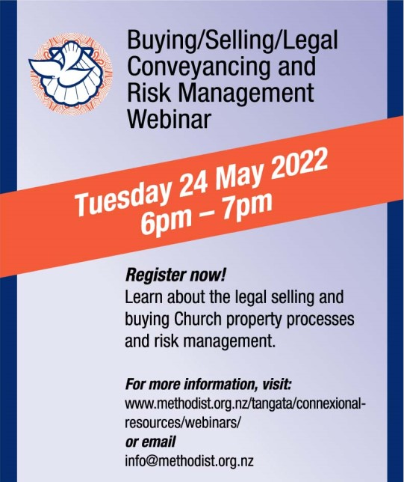
Legal conveyancing and Risk Management
Notes:
Welcome to the MCNZ webinar series. This webinar...is about Legal Conveyancing when Buying and Selling church properties, and Risk Management
Recording this webinar & relevant info on website
Background and what we do
WA – been managing P&I for over 5 yrs @ MCNZ
Background in insurance and investigations
TD - is the Wellness, Safety and Risk Advisor for MCNZ, been with MCNZ since 2017
Background in risk management with a government department and a small business in the Christchurch home repairs

Slide 2
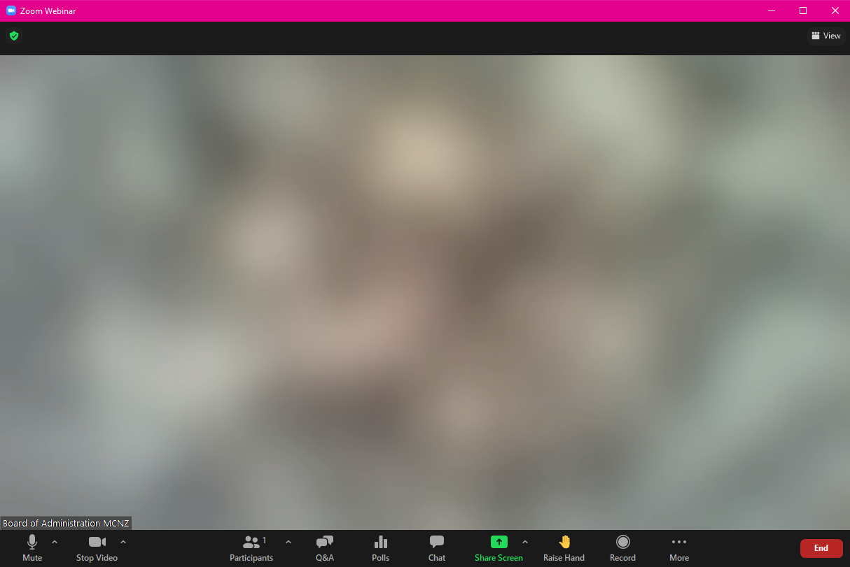
Questions
Notes:
Use the Q&A option at the bottom of your screen
Post your questions as you think of them
Questions will be answered as each speaker finishes

Slide 3
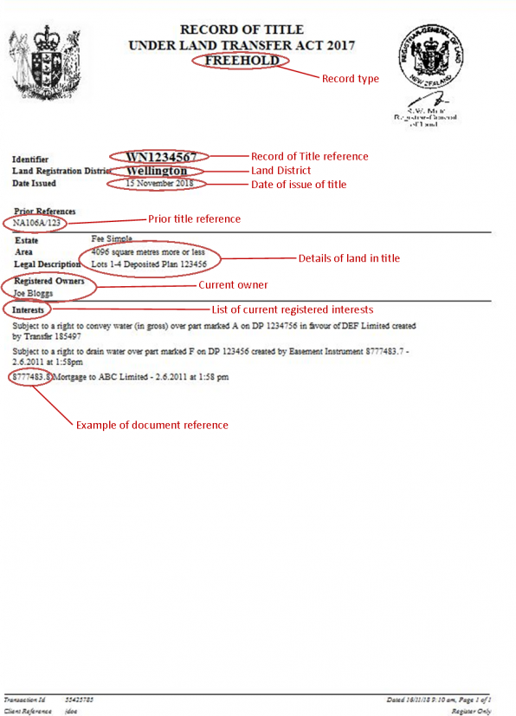
Legal conveyancing
Conveyancing is the legal transfer of a property from one owner to another. The process involves a conveyancing solicitor or licensed conveyancer who acts on behalf of the buyer to ensure their client recevies the title deeds to the property and the land it sits on.
Notes:
Property titles in MCNZ generally sit with the Board of Administration

Slide 4
Selling Church properties
What you need for the approval process
Market valuation
Builder’s report
Land story
Parish → Synod → MCPC approvals
Church lawyer
Board of Administration signature
15% contribution to Development fund
Notes:
Market valuation – from a registered valuer, NOT a real estate appraisal
Land story – copy to archives, consult with Te Taha Māori
Confiscated land
Church’s property lawyer – comes out of sales proceeds from parish account
Development Fund – 50/50 Ministry and property

Slide 5
Buying Church properties
What you need for the approval process
Market valuation
Land story
Parish → Synod → MCPC approvals
Church lawyer
Board of Administration signature
Notes:
Market valuation – from a registered valuer, NOT a real estate appraisal
Land story – copy to archives, consult with Te Taha Māori
Confiscated land
Church’s property lawyer – from parish account
Anti-money laundering

Slide 6
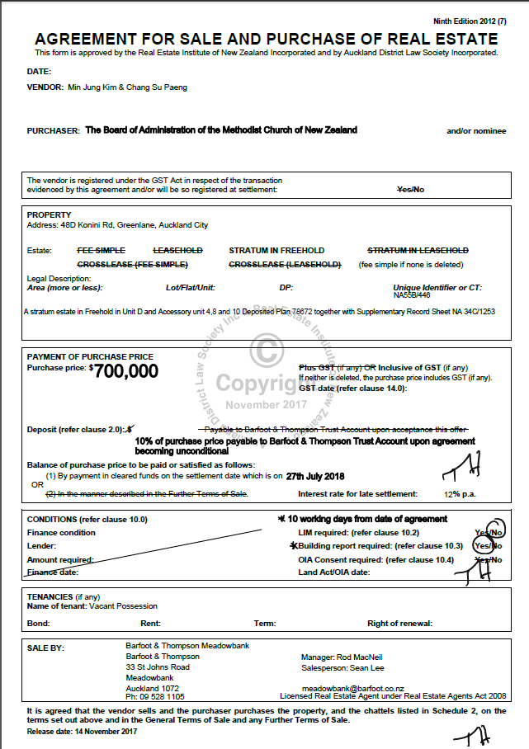

Slide 7
Notes:
GST – usually included for residential, commercial properties will have a GST component so you may want to say +GST
Get out of the contract clauses - covered for builder’s report, finance arrangements, valuations (usually in “Further terms of sale”)
Board member initials each page

Slide 8
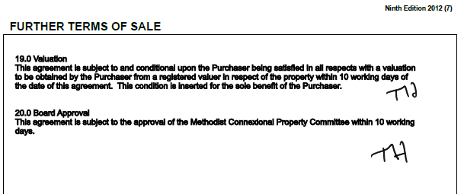
Buying a property
Notes:
If you put in an offer prior to putting into MCPC then it will need to be subject to Board approval and valuation.

Slide 9
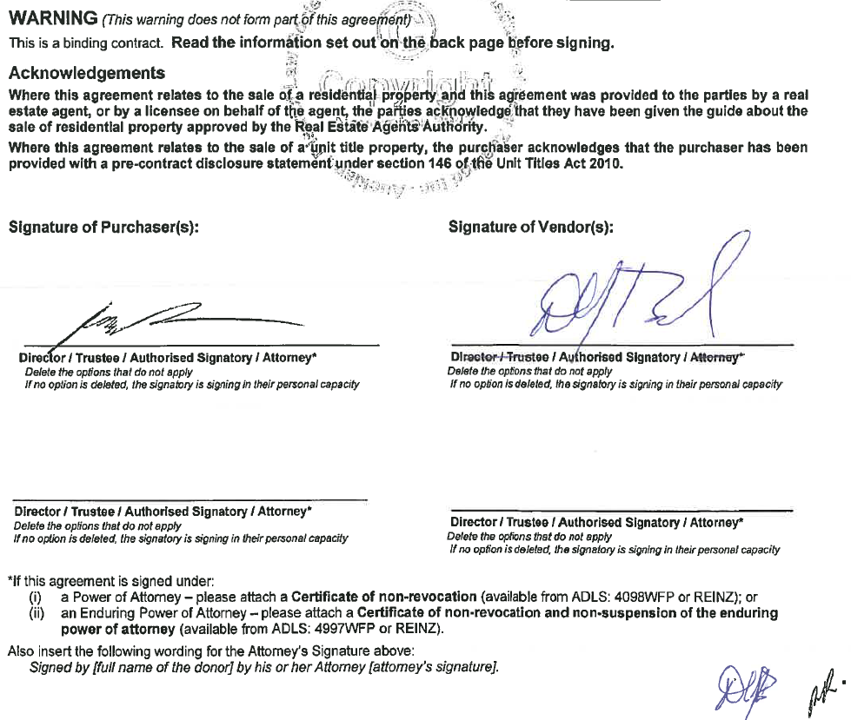
Notes:
One Board member to sign and initial all the pages
And send to Wendy A. For signing and AML docs.

Slide 10
Settlement
Lawyers fees
Miscellaneous changes
15% contribution to Development fund
CB&L Fund
Notes:
Development fund – used for Mission Resourcing and Property Development Grants (Bricks and Mortar Funds for the Church Section 15)

Slide 11
Questions?
Detailed information is available in Bricks and Mortar
https://www.methodist.org.nz/tangata/property-and-insurance/
Post-webinar questions can be directed to
Wendy Anderson
Wendya@methodist.org.nz
Notes:
Our next topic on Thursday 14 July 5-6pm is about Church’s employment claim process and managing your personal safety at work (lone workers)
All feedback or topic suggestions gratefully received
Closing Thank you for your time and interest in attending
Recording will be made available shortly on website, along with useful references to supporting material

Slide 12
Risk Management
Risk Management
Identify hazards
Assess Risk
Control Risk
Review Control
Notes:
This is the short version of risk management. It can be carried out by your property team for building hazards, by youth leaders for youth activities, or by parish councils for assessing parish activities.
I will take you through a very simplistic story to explain this diagram.

Slide 13
1. Identify the hazard
Notes:
Disclaimer: drawings not to scale

Slide 14
2. Assess the risk
Notes:
Disclaimer: drawings not to scale
Risk = trip/fall

Slide 15
2. Assess the risk
Notes:
Disclaimer: drawings not to scale
The evaluation of the risk depends on who is involved

Slide 16
2. Assess the risk
Notes:
Disclaimer: drawings not to scale
Also consider how often is the activity undertaken by how many people

Slide 17
3. Control the risk
Notes:
Disclaimer: drawings not to scale
Minimising risks is a patchwork approach, and should only be undertaken as a temporary measure.

Slide 18
3. Control the risk
Notes:
Disclaimer: drawings not to scale
Eliminating a risk should ALWAYS be the ultimate goal.

Slide 19
4. Review the control
Notes:
Disclaimer: drawings not to scale
Over time we need to check... has the control worked, or has someone tried to put the brick back!

Slide 20
Risk Register
https://www.methodist.org.nz/tangata/wellness-and-safety/other-forms/
Notes:
There is a risk register on our website to help your team work through this process.
You will need some knowledge of Excel, although there are instructions available as well if you want to do things in a more manual way.
This example is upside down – first control should always be to try to eliminate the hazard
Instead we are going to work our way up from worst control through to best control.
Risk type – a way of analysing your risks (how many fall risks, how many fire risks etc)

Slide 21
Property or safety teams to action
e.g.
Incident reported
Inspection carried out
“Everyone knows”
e.g.
Monthly meeting
Inspection carried out
e.g.
Make safe
Make known
How big and bad is it
e.g.
Group think
Brainstorm
Eliminate!
Notes:
Recap

Slide 22
Report the big stuff
Tell Trudy
Trudy will help
Lessons learned will be shared with the Connexion
trudyd@methodist.org.nz
Notes:
Finally, report the big stuff
Reporting the big stuff may help others from going through the pain that hazards and risks bring.

Slide 23
Questions?
The recording of this webinar, and all relevant information will be made available on the MCNZ website.
Questions can be directed to either
Trudy Downes or Wendy Anderson
trudyd@methodist.org.nz Wendya@methodist.org.nz
Notes:
Our next topic on Thursday 14 July 5-6pm is about Church’s employment claim process and managing your personal safety at work (lone workers)
All feedback or topic suggestions gratefully received
Closing Thank you for your time and interest in attending
Recording will be made available shortly on website, along with useful references to supporting material

