Slide 1
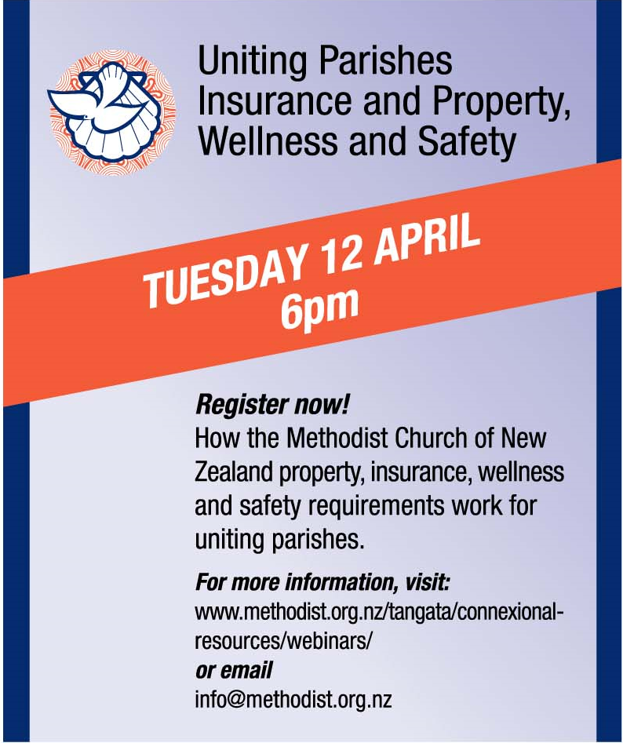
Uniting Parishes
Notes:
Welcome to the MCNZ webinar series. This webinar...Uniting Parishes Insurance and Property, Wellness and Safety
Recording this webinar & relevant info on website
Q&A– post as you think, answered at the end of each speaker with exception of questions we will be answering as we talk
Background and what we do
WA – been managing P&I for over 5 yrs @ MCNZ
Background in insurance and investigations
TD - -is the H&S Advisor for MCNZ, been with MCNZ since 2017
Background in government compliance which leads to today’s topic of getting our evacuation plans approved
PRESENTATIONS

Slide 2
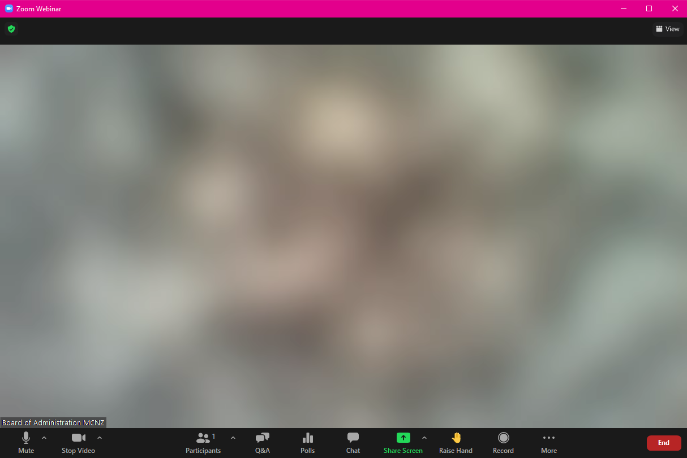
Questions
Notes:
Use the Q&A option at the bottom of your screen
Post your questions as you think of them
Questions will be answered as each speaker finishes

Slide 3



State → Church → Uniting Parishes
Notes:
Wellness/health and safety are requirements under NZ Law (generally HSWA 2015, also FENZ 2018)
This provides the what to achieve
How the Church responds is part of Church law (Conference 2018 – Caring for Our People: Emergency Response Planning, Asbestos Management Planning)
Church provides practical tools to achieve what the law requires
Obviously, the Uniting Parishes have the choice of their ‘parent’ Churches as to whose system will be followed.

Slide 4
The big stuff as a minimum...
Legislative health and safety must haves | Methodist Church provides
Incident Reporting | Process and templates, online form - webpage Incident reporting – webinar
Emergency Response Planning | Templates, guidelines, forming teams - webpage Creating a response plan – webinar Approved evacuation plans – webinar Holding emergency drills – webinar
Asbestos Management Plans | Process and templates – webpage Asbestos management - webinar
These things need to be done, which Church’s process doesn’t much matter
Notes:
Incident Reporting
Health and Safety at Work Act 2015
s57 Requirement to keep records (5 years)
s60 When engagement is required
s61 Duty to have worker participation practices
Health and Safety at Work (General Risk and Workplace management) Regulations 2016
s5 Duty to identify hazards
Emergency Response Planning
Health and Safety at Work Act 2015
Health and Safety at Work (General Risk and Workplace Management) Regulations 2016
s13 Duty to provide first aid
s14 Duty to prepare, maintain, and implement emergency plan
Health and Safety at Work (Hazardous Substances) Regulations 2017
Part 5 Subpart 1 – Fire extinguishers
Part 5 Subpart 2 – Emergency response plans
Fire and Emergency New Zealand Act 2017
Subpart 4 – Evacuation schemes
Fire and Emergency Website – Useful information
Asbestos Management
Health and Safety at Work Act 2015
Health and Safety at Work (Asbestos) Regulations 2016
Approved Code of Practice: Management and removal of asbestos 2016
Find an Asbestos Licence Holder

Slide 5
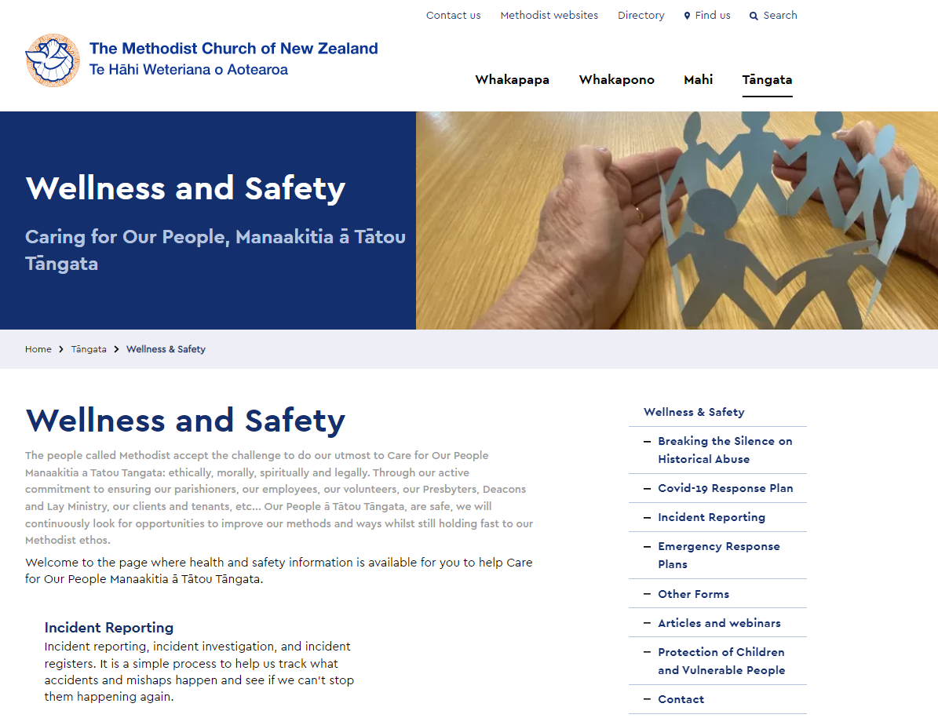
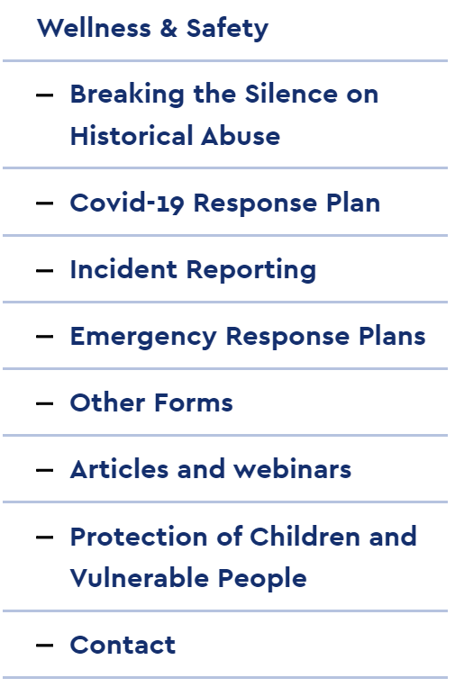
Notes:
Here is what the Methodist Church has available as resources on the website, future plans include improvements particularly to
the items under ‘other forms’ (Risk Registers, health and safety policy),
a cohesive process for Protection of Children and Vulnerable people (the Presbyterians have a fabulous process but MCNZ will probably use a safeguarding version from the Methodist Church UK)
And incorporating work from Mission Resourcing, particularly youth activities

Slide 6

How to manage parent Churches’ differences
Let us talk
Church leaders
You can tell Trudy
MCNZ Zui and webinars
Facemasks and vaccine passes!
It’s the additional responses that cause dilemmas
Notes:
(Not that you need us to say it!)
With the legislative stuff – we just have to do it, and I have no preference whose examples are used so long as it is done.
But then there are areas of care where the standards can be completely different. I raise the MCNZ Covid-19 Response Plan as an example of:
I know there are differences between MCNZ and the other parent Churches. Where I know about the differences, I have highlighted them to make life easier.
There were big differences (MCNZ’s early adoption of facemasks all the time, and mandatory use of vaccine passes)
How MCNZ
If you discover differences that aversely affect your parish. Please let me know. (and this is not just for the Covid-19 Response).

Slide 7
Uniting Parishes Property Approval Process
Sale, Purchase and Building Projects
Both/all denominations should be involved
Agreement with Presbyterian that both denominations involved in process, regardless of who holds the title
Ratio adjustments required for Property Development Grants
Approval required from:
    Parish
    Synod
    Presbytery / Presbyterian Church Property Trustees or Anglican Diocese
    MCPC
Notes:
Wanted to talk on the process for property and insurance
Process for Uniting parishes is a different as the parish has more than one denomination with an interest in the property with their own processes
Forgive my I am working blind as I am working remotely. But we will do the best we can.
Involvement of the partner churches for approval

Slide 8
Three step approval process for projects:
  Approval of concept plans and to proceed to working drawings (lodge resource consent if necessary)
  Approval of working drawings (and costs), lodge building consent and invite tenders
  Award contract (project costs finalised)
  Don’t forget Contract Works Insurance once approval has been granted.
  CWI can take 2-3 weeks

Slide 9
Liability Insurance
MCNZ provides cover, free of charge for:
  Cyber and Privacy Risk
  Directors and Officers Liability
  Employment Disputes Liability
  Employers Liability
  Professional indemnity and / or errors or omissions
  Statutory Liability
  General Liability
  Medical Malpractice
  Fidelity / Computer Crime
Notes:
Cyber and Privacy Risk Specialised cover for protection of internet and network exposures some of which are excluded from traditional Material Damage and Business Interruption policies. Cover is also available to protect the company's reputation should a breach of cyber privacy occur.
Directors and Officers Liability (Side A & B) To cover directors, executives and employees against liability they might incur in carrying out the duties of a company director
Employment Disputes Liability To cover damages and costs arising out of certain employment related disputes such as wrongful termination, harassment and discrimination. Defence costs.
Employers Liability Covers claims made by employees against employers for injury or illness occurring in the workplace where cover falls outside the scope of accident compensation legislation. Defence costs.
Professional Indemnity and / or Errors & Omissions To cover legal liability incurred by giving negligent advice or through a breach of professional duty. Defence costs.
Statutory Liability To cover fines or penalties imposed for unintentional breaches of certain statutes. Defence costs.
General Liability To cover claims from third parties for property damage or bodily injury arising out of the business activities of the insured (sometimes referred to as ‘Public Liability’ insurance). Defence Costs.
Medical Malpractice
Covers claims from third parties arising from an allegation of a Medical Incident in the conduct of Professional Healthcare Services provided that arises from an act, error or omission. Defence costs.
Fidelity / Computer Crime To cover theft by employees; this risk is commonly excluded from cover under Material damage insurance.

Slide 10
Liaiblity Insurance cont.
Uniting Parishes a combination of two or possibly three denominations
Not necessarily any connection with either denomination, “We are a Uniting Parish”
No control for MCNZ for liability breaches
  Liability to cover MCNZ interest and reputation
  MCNZ not responsible for other denominations
Insurer expectation that other denominations will contribute to any liability claim
Notes:
Not necessarily any connection with either denomination, “We are a Uniting Parish”
As Trudy has already covered – uniting parishes may only follow parent’ Churches as to whose system will be followed
Other denominations do not provide the level of cover MCNZ does and also charge for the limited cover provided

Slide 11
Removals – Minister’s Moving Costs
Methodist removal scheme including transit insurance cover
Separate scheme for Uniting Parishes administered by UCANZ
UCANZ scheme funded by a levy on each uniting parish
MCNZ can organize the quote for UCANZ but speak with UCANZ
Notes:
The Connexional Office is responsible for the administration of a removal scheme which pays for the removal costs of Ministers and their families. This scheme is financed by a levy from all Methodist parishes, based on membership.
A second scheme was established for Uniting Parishes (Combined Ventures (CVs) who may choose to join the Uniting Churches of Aotearoa New Zealand (UCANZ) Removal Scheme which is funded by a levy on each of the parishes who are members of the scheme. Further information relating to this may be obtained from UCANZ who administer the scheme.

Slide 12
Service Tenancy Agreement
To be used for Methodist properties
Customised for MCNZ properties
Legal opinion was sought – advised it is illegal to house a minister in a parsonage without a tenancy agreement
Page 117 Bricks and Mortar, Appendix 2
This form is available on the Methodist Church website: http://www.methodist.org.nz
Notes:
The Premises is being made available for use as a parsonage to provide accommodation to the Minister stationed at the Parish.
In consideration for making the Property available for use as a parsonage the Parish requires the Minister to enter a tenancy agreement.
The Parish is unable to contract out of its obligation to have a tenancy agreement.
Accordingly, the Parish has agreed to grant, and the Minister has accepted a tenancy of the Premises on the terms set out in this agreement.
This is the official tenancy agreement to be used by all Parishes for their Minister’s tenancy agreement.
A copy of the signed agreement to be provided to the Board of Administration of the Methodist Church within a month of the occupancy or induction, whichever is the later.

Slide 13
Questions?
The recording of this webinar, and all relevant information will be made available on the MCNZ website.
Questions can be directed to either
Trudy Downes or Wendy Anderson
trudyd@methodist.org.nz Wendya@methodist.org.nz
Notes:
Our May topics will be Risk and Legal Conveyancing
All feedback or topic suggestions gratefully received
Closing Thank you for your time and interest in attending
Recording will be made available shortly on website, along with useful references to supporting material

