Slide 1
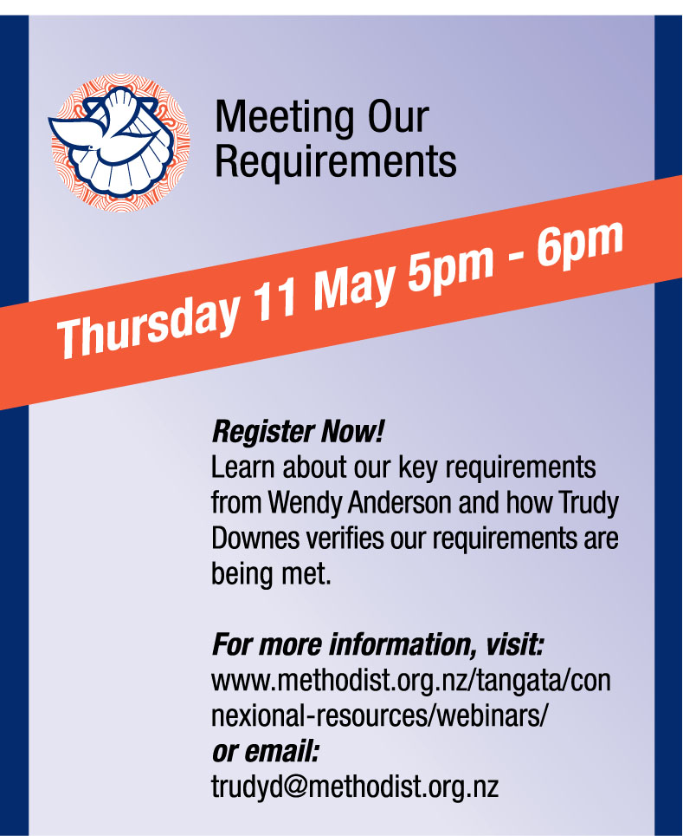
Meeting our requirements
Notes:
Welcome to the MCNZ webinar series for 2023. This webinar is about...MEETING OUR REQUIREMENTS
Recording this webinar & relevant info on website
Q&A– post as you think, answered at the end of each speaker with exception of questions we will be answering as we talk
Background and what we do
WA – been managing P&I for over 7 yrs @ MCNZ
Background in insurance and investigations
TD - -is the H&S Advisor for MCNZ, been with MCNZ since 2017
Background in government compliance which leads to today’s topic of verifying building compliance
PRESENTATIONS

Slide 2
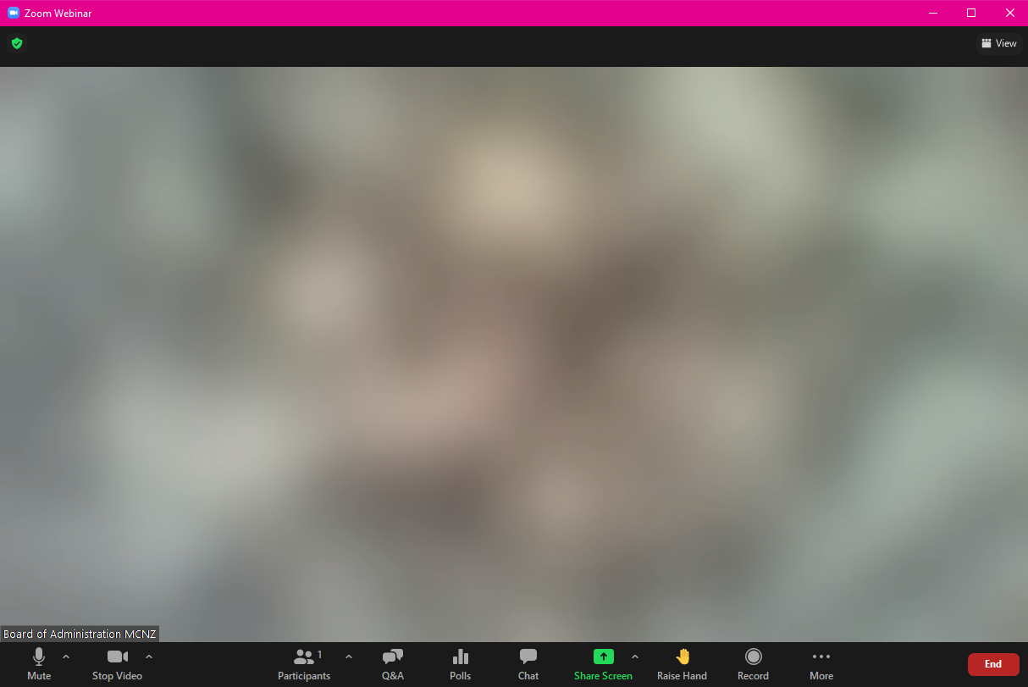
Questions
Notes:
Use the Q&A option at the bottom of your screen
Post your questions as you think of them
Questions will be answered as each speaker finishes

Slide 3
Building Stages
Concept
Consent
Tender/Award Contract
Commence
In Progress- Variations
Practical Completion
Defects Liability
Ongoing (Residential, Commercial)
Notes:
Building stages where MCPC need to be approving.
Larger projects need 3 MCPC approvals
Concept approval – use the MCPC experts
Consent approval – working drawings, seek tenders (firm up proposed costs)
Contractor approval
While most of our existing buildings are in the “ongoing stage”, any building project will go through the other stages which will all have different compliance requirements which we will talk about now.

Slide 4
Buying and Selling Church Properties
What you need for the approval process
Market valuation
Builder’s report (buying)
Land story
Parish → Synod → MCPC approvals
Church lawyer
Board of Administration signature
15% contribution to Development fund (selling)
Notes:
Market valuation – from a registered valuer, NOT a real estate appraisal
Land story – copy to archives, consult with Te Taha Māori
Confiscated land
Church’s property lawyer – comes out of sales proceeds from parish account
Development Fund – 50/50 Ministry and property
Anti-money laundering

Slide 5
Building
Best practice (church process) | Governmental compliance | Costs
Project Management | Asbestos Management Plan (webinar Aug 2021) | Original Survey
Architect | Heritage NZ consultation | N/A
Quantity Surveyor | Local council for Resource Consent (administering the Building Act and bylaws) | May be triggered
Fire Consultant
Geotech engineer
Strategic Plan
Local iwi consultation
Notes:
The ideas on paper.
Consider your wish list to the architect:
Building use
Rental – wide halls reduce future maintenance
Disability access – doorways and facilities
Heatpump units placed for safe future maintenance
Design considerations for the building
Separate ventilation for separate areas
Notice boards
Entry/exits for separate areas
Audio/Visual wiring – central setup for multiple areas
Hand sanitiser stations
Asbestos management webinar Aug 2021

Slide 6
Consent
Best practice (church process) | Governmental compliance | Costs
Heritage Architect (liaising with Heritage NZ) | Local council for building consent (District Plan, and Building Act 2004) | Lodgement
Archaelogical consultant
Invite tenders (indicative costings) | Health and Safety at Work Act 2015
 | Asbestos Refurbishment/Demolition Survey

Slide 7
Start work
Best practice (church process) | Governmental compliance | Costs
Contract Works Insurance (as Principal)
Site Health and Safety hazards | Health and Safety at Work Act 2015 | Included
Engineer sign offs | Local council sign offs | Sign offs
Public Liability (Contractor’s)
Storage
Notes:
Play an active part in the Contractor’s H&S plan if you are still on or near site during construction (Wellington Wesley).
Storage – avoid dust and damage while building works is going on

Slide 8
Tender/Award Contracts
Best practice (church process) | Governmental compliance | Costs
MCPC approval | Construction Contracts Act 2002 | N/A
Legal consultation may be necessary |  | Potential
Notes:
MCPC
Costs (up to date costs, rather than original estimates)
Funding
Strategy
The Construction Contracts Act 2002 (the Act) provides a process for dealing with payments and disputes under a construction contract.

Slide 9
Compliance looks different for different entities
How many buildings?
How are they used?
Who manages the building?
Are they connected?
Who has access, when?
How many sites?
Landlord or Tenant?
Notes:
I am focussing on compliance associated with our buildings, not necessarily our activities
Because not all Church entities are equal
Our Missions
A parish
A Campground
A preschool
A School
A rohe
A council or committee
Our level of management and compliance needs to be comparative to the number of properties we manage.

Slide 10
The legislation driving compliance
Legislation | Compliance
Health and Safety at Work Act 2015 https://www.legislation.govt.nz/act/public/2015/0070/latest/link.aspx?search=qs_act%40bill%40regulation%40deemedreg_health+and+safety+regulation_resel_25_a&p=7 | Due diligence Consult, Coordinate, Cooperate
Building Act 2004, Part 2, Subpart 1, s15 https://www.legislation.govt.nz/act/public/2004/0072/latest/DLM306334.html?search=sw_096be8ed81c9110f_%22warrant+of+fitness%22_25_se&p=1&sr=2 | Building Warrants of Fitness
Health and Safety at Work (Asbestos) Regulations https://www.legislation.govt.nz/regulation/public/2016/0015/latest/link.aspx?search=qs_act%40bill%40regulation%40deemedreg_asbestos_resel_25_h&p=1 | Asbestos Management
Fire and Emergency New Zealand (Fire Safety, Evacuation Procedures, and Evacuation Schemes) Regulations 2018 https://www.legislation.govt.nz/regulation/public/2018/0096/latest/link.aspx?search=qs_act%40bill%40regulation%40deemedreg_evacuation_resel_25_h&p=1 | Approved Evacuation Schemes
Health and Safety at Work (General Risk and Workplace Management) Regulations 2016 https://www.legislation.govt.nz/regulation/public/2016/0013/latest/DLM6727582.html?search=qs_act%40bill%40regulation%40deemedreg_health+and+safety+regulation_resel_25_a&p=7 | Emergency Response Plans Incident Reporting Identify and manage hazards
Notes:
I don’t just make this stuff up!

Slide 11
More specialised areas
Legislation | Compliance
Health and Safety at Work (Hazardous Substances) Regulations 2017 https://www.legislation.govt.nz/regulation/public/2017/0131/latest/link.aspx?search=qs_act%40bill%40regulation%40deemedreg_hazardous+substances_resel_25_h&p=1 | Hazardous Substance Management
Health and Safety at Work (Adventure Activities) Regulations 2016 https://www.legislation.govt.nz/regulation/public/2016/0019/latest/link.aspx?search=qs_act%40bill%40regulation%40deemedreg_health+and+safety+regulation_resel_25_a&p=7 | Some camp activities

Slide 12
Know the basics about your property
Risk id | Item description | Street Address | Suburb | Town / City | Post Code | Built Pre 1920 | Built 1920-2001 | Built post 2001 | Reno's post build
E100768 | St Johns Golden Church 149 Kamo Ro 149 Kamo Road Kensington Whangarei 0112 | 149 Kamo Road | Kensington | Whangarei | 0112 |  | 1965
E111740 | Law Centre 149 Kamo Road Kensington Whangarei 0112 | 149 Kamo Road | Kensington | Whangarei | 0112 |  | 2000
E100771 | Opp Shop Skyline Garage 149 Kamo 149 Kamo Road Kensington Whangarei 0112 | 149 Kamo Road | Kensington | Whangarei | 0112 |  |  | 2007
E100770 | St Johns Daycare Centre 149 Kamo Road Kensington Whangarei 0112 | 149 Kamo Road | Kensington | Whangarei | 0112 |  | 1993
E100769 | St Johns Parsonage Whangarei 149 Kamo Road Kensington Whangarei 0112 | 149 Kamo Road | Kensington | Whangarei | 0112 |  | 1944
E100751 | King St Hikurangi Hall Plus Lean To 17 King Street Hikurangi 0114 | 17 King Street |  | Hikurangi | 0114 |  | 1950
E100749 | King Street Hikurangi Church Only 17 King Street Hikurangi 0114 | 17 King Street |  | Hikurangi | 0114 | 1900
Notes:
What are the basics for your Church entity?
Are you landlord or tenant?

Slide 13
Asbestos Management and BWoF
Risk id | Item description | Street Address | Suburb | Town / City | Post Code | AMP Rec'd | Comment | Managed | In Progress | 2B confirmed | BWoF needed | BWof No | Expiry date
E102020 | 158 Opawa Road Community Ministry 158 Opawa Road Hillsborough Christchurch 8022 | 158 Opawa Road | Hillsborough | Christchurch | 8022 | 26/06/18 |  | 1 |  |  | No |  | .
E110450 | New Brighton Union Church Union Street New Brighton Christchurch 8061 | 24 Union Street | New Brighton | Christchurch | 8061 | 30/01/20 | Needs floor plan | 1 |  |  | Yes | WOF/2020/5667 | 01/03/24
E101665 | 10A Grange Street Opawa Christchurch 8022 | 10A Grange Street | Opawa | Christchurch | 8022 | 26/06/18 | email sent to AD |  | 1 |  | No |  | .
E110873 | Garage - 9 Aynsley Terrace Christchurch 8022 | 9 Aynsley Terrace |  | Christchurch | 8022 | 26/06/18 | TD provided paperwork. Unsure if parish understands | 1 |  |  | No |  | .
E101649 | New Brighton Union Parish Hall 24 24 Union Street New Brighton Christchurch 8061 | 24 Union Street | New Brighton | Christchurch | 8061 | 30/01/20 | Needs floor plan | 1 |  |  | included |  | .
E101668 | 120 Colombo Street Beckenham 120 Colombo Street Beckenham Christchurch 8023 | 120 Colombo Street | Beckenham | Christchurch | 8023 |  |  |  | 1 |  | No |  | .
E101664 | Opawa Community Church 3 - 7 Aynsl 3 - 7 Aynsley Terrace Hillsborough Christchurch 8022 | 3 - 7 Aynsley Terrace | Hillsborough | Christchurch | 8022 | 26/06/18 |  | 1 |  |  | Yes | WOF/2020/5087 | 01/12/23
E105292 | 40 Somerset Crescent Spreydon Christchurch 8024 | 40 Somerset Crescent | Spreydon | Christchurch | 8024 |  | Emailed Moi 29/6/18. Also, substantial rebuild of church and hall carried out. School and kava rooms out back need work |  | 1 |  | No |  | .
Notes:
This is recording if things are being done.
How to do it is on our website

Slide 14
FENZ Approved Evacuations
Risk id | Item description | Street Address | Suburb | Town / City | Post Code | 100> people | 10> workers | 6> sleep, unless 3< households | Hazardous substances | Early childhood, medical, disabled | Required | Approval Issued
E102020 | 158 Opawa Road Community Ministry 158 Opawa Road Hillsborough Christchurch 8022 | 158 Opawa Road | Hillsborough | Christchurch | 8022 | Yes |  |  |  |  | YES
E110450 | New Brighton Union Church Union Street New Brighton Christchurch 8061 | 24 Union Street | New Brighton | Christchurch | 8061 | Yes |  |  |  |  | YES
E101665 | 10A Grange Street Opawa Christchurch 8022 | 10A Grange Street | Opawa | Christchurch | 8022 | No | No | No | No | No | No
E110873 | Garage - 9 Aynsley Terrace Christchurch 8022 | 9 Aynsley Terrace |  | Christchurch | 8022 | No | No | No | No | No | No
E101649 | New Brighton Union Parish Hall 24 24 Union Street New Brighton Christchurch 8061 | 24 Union Street | New Brighton | Christchurch | 8061 | Yes |  |  |  |  | YES
E101668 | 120 Colombo Street Beckenham 120 Colombo Street Beckenham Christchurch 8023 | 120 Colombo Street | Beckenham | Christchurch | 8023 | No | No | No | No | No | No
E101664 | Opawa Community Church 3 - 7 Aynsl 3 - 7 Aynsley Terrace Hillsborough Christchurch 8022 | 3 - 7 Aynsley Terrace | Hillsborough | Christchurch | 8022 | Yes |  |  |  |  | YES
E105292 | 40 Somerset Crescent Spreydon Christchurch 8024 | 40 Somerset Crescent | Spreydon | Christchurch | 8024 | No | No | No | No | No | No

Slide 15
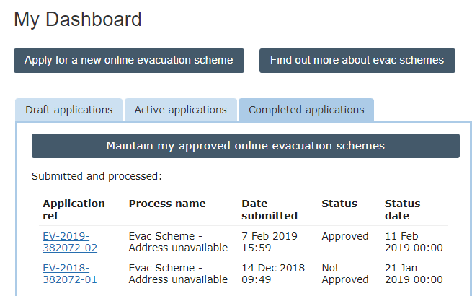
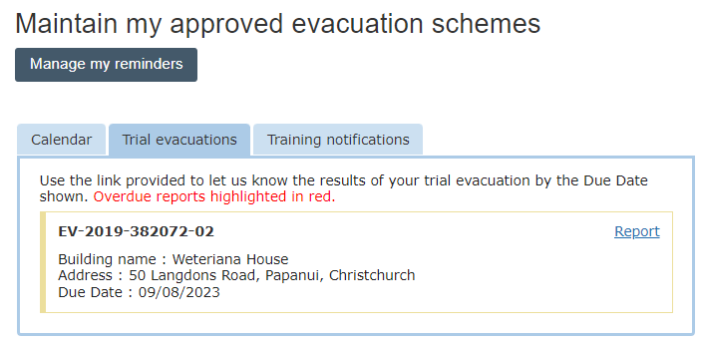
FENZ Results

Slide 16
Verification Sources
MCPC | Word of Mouth | Visits
Councils | FENZ | The personal touch

Slide 17
Questions?
The recording of this webinar, and all relevant information will be made available on the MCNZ website.
Questions can be directed to either
Trudy Downes or Wendy Anderson
trudyd@methodist.org.nz Wendya@methodist.org.nz
Notes:
Our next topic on Thu June 08 5pm is about Leases and Tenancies
All feedback or topic suggestions gratefully received
Closing Thank you for your time and interest in attending
Recording will be made available shortly on website, along with useful references to supporting material

