Slide 1
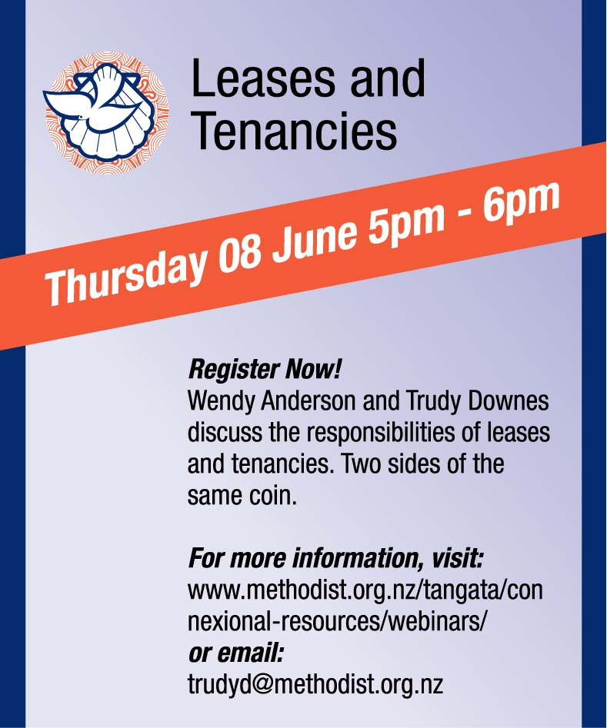
Leases and Tenancies
Notes:
Welcome to the MCNZ webinar series. This webinar...Leases and Tenancies
Recording this webinar & relevant info on website
Background and what we do
WA – been managing P&I for over 7 yrs @ MCNZ
Background in insurance and investigations
TD - -is the H&S Advisor for MCNZ, been with MCNZ since 2017
Next slide – Webinar Housekeeping

Slide 2
Questions
Notes:
Use the Q&A option at the bottom of your screen
Q&A– post as you think, answered at the end of each speaker with exception of questions we will be answering as we talk
Post your questions as you think of them
Questions will be answered as each speaker finishes

Slide 3
Leases and Tenancies – relate to...
Leases – Commercial buildings and land
Tenancies – Residential buildings

Slide 4
Deed of Lease (Commercial)
Notes:
If you want a lease drawn up – talk to Wendy or send a copy of the old lease for a renewal
This is a requirement for all commercial property leases (leased out to others or leased by church entities)
These must be drawn up for the landlord by the Church lawyer, not the tenant
The Church lawyer will supply the blank forms for him to complete
Terms over 7 years including rights to renew require MCPC approval
Landlord is the Board of Administration of the Methodist Church of NZ
Exception: boards or trusts with property in their name
Other forms of lease – land lease – residential and commercial

Slide 5
Signatures
Notes:
Signed by BoA member (or other board or trust per their constitution)
AML should not affect leases because...
Assuming parish owned → BoA signature, send the lease agreement to the Connexional Office
Signature witness

Slide 6
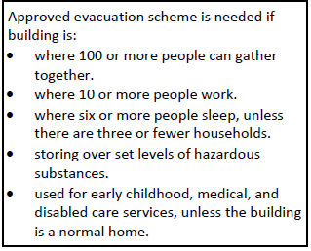
You are the leasor-landlord, so you are responsible for...
Evacuation drills
Building warrants of Fitness (if applicable)
Building maintenance
Building asbestos management plan

Slide 7
You are the leasee-tenant, you are responsible for...
Participate in building evacuations (supply a building warden)
Supply your own emergency response plan for you and your team (supply a first aider)
Supply your own first aid kit
Report all building issues
Read and abide by the landlord’s asbestos management plan
Notes:
If you don’t have building evacuations – get the landlord to sort them out.

Slide 8
You are a room-hirer, you are responsible for...
Participate in building evacuations (supply a building warden)
Ideally supply your own emergency response plan for you and your team (ideally supply a first aider)
Supply your own first aid kit
Report all building issues
Read and abide by the landlord’s asbestos management plan
Notes:
According to the room hire agreement

Slide 9
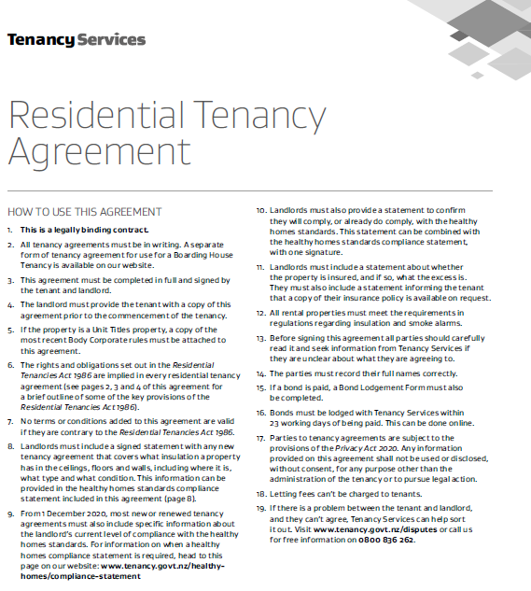
Residential Tenancy obligations
Notes:
A link to this document will be included in the webinar notes.
Tenancy Services – Residential Tenancy Agreement
Mandatory form – it is a legal requirement for the terms of your tenancy to be in a written agreement. A landlord who does not provide a written, signed tenancy agreement and ensure that a copy is given to their tenant, is breaking the law and could be fined.
Mandatory Bond – to Tenancy Services

Slide 10
Smoke alarms
› Comply with all requirements in respect of smoke alarms imposed on the landlord by regulations.
› Landlords need to have working smoke alarms installed in all their residential rental homes. Any replacement alarms installed after 1 July 2016 (other than hard-wired systems) need to have long life batteries and a photoelectric sensor.
Notes:
Page 2 of the Tenancy Services Agreement
(RH column, 2nd and 3rd paragraphs)
› Comply with all requirements in respect of smoke alarms imposed on the landlord by regulations.
› Landlords need to have working smoke alarms installed in all their residential rental homes. Any replacement alarms installed after 1 July 2016 (other than hard-wired systems) need to have long life batteries and a photoelectric sensor
Photoelectric Sensors detect objects, changes in surface conditions, and other items through a variety of optical properties. A Photoelectric Sensor consists primarily of an Emitter for emitting light and a Receiver for receiving light.
Online around $40 / 10 battery year life (printed B&M page 47)

Slide 11
Healthy Home obligations
Notes:
In the Residential Tenancy Agreement
Key dates – tenancy.govt.nz/healthy-homes/healthy-homes-compliance-timeframes
New tenancies must comply – from 01/07/21
All tenancies must comply – by 01/07/25
Housing NZ – by 01/07/24
List requirements – a list of websites will be made available
Heating – comprehensive heating standard – visit tenancy.govt.nz/healthy-homes/heating-standard
Insulation – 5 pages in tenancy agreement – visit tenancy.govt.nz/healthy-homes/insulation-standard
Ventilation – kitchens/bathrooms extraction rangehoods - visit tenancy.govt.nz/healthy-homes/ventilation-standard
Moisture ingress and drainage standard – visit tenancy.govt.nz/healthy-homes/moisture-and-drainage-standard
Draught stopping - visit tenancy.govt.nz/healthy-homes/draught

Slide 12
The websites
https://www.tenancy.govt.nz/
https://www.tenancy.govt.nz/healthy-homes/healthy-homes-compliance-timeframes
https://www.tenancy.govt.nz/healthy-homes/heating-standard
https://www.tenancy.govt.nz/healthy-homes/insulation-standard
https://www.tenancy.govt.nz/healthy-homes/ventilation-standard
https://www.tenancy.govt.nz/healthy-homes/moisture-and-drainage-standard
https://www.tenancy.govt.nz/healthy-homes/draught

Slide 13
Contractors
Vs.
Notes:
If Contractors are in a home, it is a worksite
We have the responsibility to work with Contractors to help them manage the risk of:
Mould
Asbestos
Tenants
Pets
Evacuation points
And other risks that may be encountered in the residency
We have the responsibility to work with tenants (if they are still residing in the tenancy at the time of the work)
Qualified contractors
Agreed work times
Contact names and numbers
Remove loose/valuable items (valuable could mean sentimental value) from risk of breakage or misappropriation
We should have agreed rules for everyone, such as
No worker should be left alone with the tenant’s children or pets
Shut doors = no go areas
Agreed work times

Slide 14
Tenancy Insurance
Notes:
We have a statement
Who is the insurance company
What is the excess
Information that is relevant for the tenant’s damage to the premises
Provide a statement informing the tenant that a copy of the insurance policy is available on request
Complete the table regarding name/type policy [Material damage, maybe contents]Insurer [Concordia underwriting panel includes QBE Insurance Australia Ltd and certain underwriters at Lloyds of London
Excess:
For buildings served by an operating alarm system at the time of a loss occasioned by fire vandalism or burglary – Excess $500 per claim.
Water damage claims – Excess $2,000
For all other claims for a property without an operating alarm system– Excess $1,000 per claim.
Loss of money claims– Standard excess $250.
For co-operative ventures, the appropriate excess plus GST.

Slide 15
Tenancy rights
Lessons learned:
Insurance claims in action webinar 22 Sept 2022 https://www.methodist.org.nz/tangata/connexional-resources/webinars/insurance-claims-in-action-webinar/
Loafers Lodge tragedy, Wellington
Notes:
From the recent Loafers Lodge tragedy in Wellington.
Wellington Community Law senior lawyer Oscar Upperton told Checkpoint boarding house residents were technically tenants for the purpose of rental law: "As long as they are intending to stay at the property - or they stay at the property in fact - for more than 28 days then they are covered just like any other tenant. Their landlord has the same obligations that any other landlord would have."
The landlord must provide the property in a clean state, repair and maintain it, provide it with working and compliant smoke alarms and meet all other laws that are relevant, for example the Building Act, Upperton says. [this is particularly where our responsibility to provide healthy homes kicks in]
In the event of a catastrophic event that means tenants can no longer live there, they can give two days notice to end their tenancy.
"Their rent abates accordingly - so if they've already paid some rent up front, they should get that rent back, if they're currently paying rent their rent can stop from that date.“
But "it's not on the landlord to find them some place to live", he said.

Slide 16
Questions?
The recording of this webinar, and all relevant information will be made available on the MCNZ website.
Questions can be directed to either
Trudy Downes or Wendy Anderson
trudyd@methodist.org.nz Wendya@methodist.org.nz
Notes:
Our next topic on Thu 14 september will be about Risk Management
All feedback or topic suggestions gratefully received
Closing Thank you for your time and interest in attending
Recording will be made available shortly on website, along with useful references to supporting material

