Slide 1
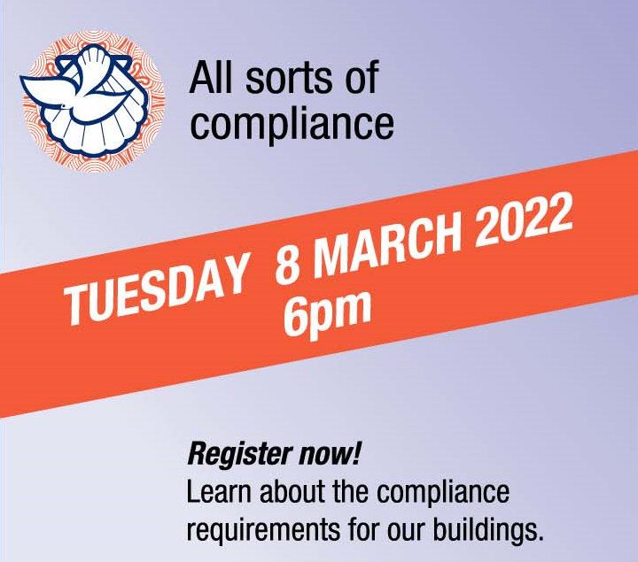
Compliance
Notes:
Welcome to the MCNZ webinar series. This webinar...COMPLIANCE
Recording this webinar & relevant info on website
Q&A– post as you think, we will try to answer as we talk
Background and what we do
WA – been managing P&I for over 5 yrs @ MCNZ
Background in insurance and investigations
TD - -is the H&S Advisor for MCNZ, been with MCNZ since 2017
Background in government compliance which leads to today’s topic of getting our evacuation plans approved
Before we begin...

Slide 2
Use the Q&A option to ask any questions
Notes:
Use the Q&A option at the bottom of your screen
Post your questions as you think of them
Questions will be answered as each speaker finishes

Slide 3
Building Management Compliance Webinar agenda
Governing bodies: Local, regional and central government
Building stages
Notes:
Today we will discuss the different types of compliance needed for Central and Local Government
Broken down into the different building stages of interaction needed with MCPC

Slide 4
Governing bodies
Local councils
Regional environmental councils
Heritage New Zealand Pouhere Taonga
Department of Internal Affairs
Fire and Emergency NZ
MBIE (Ministry of Business Innovation and Employment)
WorkSafe
Tenancy Services
Building Act 2004
Earthquake/Siesmic strengthening
Ministry of Justice
Anti-Money Laundering and Countering Financing of Terrorism Act 2009
Notes:
Bricks and Mortar Section 1 page 8
Building Act 2004
Building (Earthquake-prone Buildings) Amendment Act 2016
Resource Management Act 1991
Fire and Emergency NZ (Fire Safety Evacuation Procedures and Evacuation Schemes) Regulations 2018
Heritage New Zealand Pouhere Taonga Act 2014
Health and Safety at Work Act 2015 (and associated regulations).
The Connexional Office interprets all of this law into a way that can be followed by the entities of MCNZ.

Slide 5
Building Stages
Concept
Consent
Tender/Award Contract
Commence
In Progress- Variations
Practical Completion
Defects Liability
Ongoing (Residential, Commercial)
Notes:
Building stages where MCPC need to be approving.
Larger projects need 3 MCPC approvals
Concept approval – use the MCPC experts
Consent approval – working drawings, seek tenders (firm up proposed costs)
Contractor approval
While most of our existing buildings are in the “ongoing stage”, any building project will go through the other stages which will all have different compliance requirements which we will talk about now.

Slide 6
1. Concept
Best practice (church process) | Governmental compliance | Costs
Project Management | Asbestos Management Plan (webinar Aug 2021) | Original Survey
Architect | Heritage NZ consultation | N/A
Quantity Surveyor | Local council for Resource Consent (administering the Building Act and bylaws) | May be triggered
Fire Consultant
Geotech engineer
Strategic Plan
Local iwi consultation
Notes:
The ideas on paper.
Consider your wish list to the architect:
Building use
Rental – wide halls reduce future maintenance
Disability access – doorways and facilities
Heatpump units placed for safe future maintenance
Covid lessons for future use of our Church Buildings
Separate ventilation for separate areas
Notice boards
Entry/exits for separate areas
Audio/Visual wiring – central setup for multiple areas
Hand sanitiser stations
Asbestos management webinar Aug 2021

Slide 7
Christchurch Basilica
Notes:
The thoughts that went behind the Concept work that the Catholic Diocese went through.
$3M for a resource consent for demolition

Slide 8
2. Consent
Best practice (church process) | Governmental compliance | Costs
Heritage Architect (liaising with Heritage NZ) | Local council for building consent (District Plan, and Building Act 2004) | Lodgement
Archaelogical consultant
Invite tenders (indicative costings) | Health and Safety at Work Act 2015
 | Asbestos Refurbishment/Demolition Survey
Notes:
Wendy

Slide 9
Construction projects
ORGANISATIONS
Notes:
Inviting Tenders - Contractor assessment
Health and safety process – do they actually do what they say they will do
Confirmation all their onsite staff are vaccinated
Understand the hazards that will be introduced with the building works – be part of the soluation
Notifiable hazardous work – working over 5m (and scaffolding), asbestos removal, overhead lines, tree felling, excavation trenches
Do they have – do you expect any H&S prequalifications (SiteWise, Tōtika, Worksafe have a questionnaire)
Overlapping duties
“We hired a consultant” does not remove your responsibilities.
Webinar June 2021 – Stds of care

Slide 10
3. Tender/Award Contracts
Best practice (church process) | Governmental compliance | Costs
MCPC approval | Construction Contracts Act 2002 | N/A
Legal consultation may be necessary |  | Potential
Notes:
MCPC
Costs (up to date costs, rather than original estimates)
Funding
Strategy
The Construction Contracts Act 2002 (the Act) provides a process for dealing with payments and disputes under a construction contract.

Slide 11
4. Commence
Best practice (church process) | Governmental compliance | Costs
Contract Works Insurance (as Principal)
Site Health and Safety hazards | Health and Safety at Work Act 2015 | Included
Engineer sign offs | Local council sign offs | Sign offs
Public Liability (Contractor’s)
Storage
Notes:
Play an active part in the Contractor’s H&S plan if you are still on or near site during construction (Wellington Wesley).
Storage – avoid dust and damage while building works is going on

Slide 12
5. In-progress/variations
Best practice (church process) | Governmental compliance | Costs
 | Construction Contracts Amendment Act 2015
Ongoing Health and Safety hazards | Health and Safety at Work Act 2015 | Included
Notes:
Construction Contracts Amendment Act 2015 (Retentions)
The Construction Contracts Amendment Act 2015 (CCAA) and the Regulatory Systems (commercial Matters) Amendment Act 2017 put in place new requirements for protecting retention money.
Variations: ideas have changed, or issues are identified as the project progresses (asbestos, ground conditions)
Good project managers are worthwhile at this stage, as are good/thorough original scoping and tender/contract documents and plans.
Payments go through the CB&L fund Webinar Aug 2021
The ability to shut down a site – Principal, and H&S Representatives
Asbestos may be discovered once surfaces are removed (wall linings removed)

Slide 13
Asbestos Management Plan
Demolition/Refurbishment Asbestos Survey
Demolition/Refurbishment Asbestos Survey
Demolition/Refurbishment Asbestos Survey
ASBESTOS FREE BUILDING!
Notes:
Projects may start and stop as asbestos is identified and dealt with.
Be aware that if your building is aged between 1920 and 2000 there is a likely hood of asbestos
There may be additional work required during your building project and if asbestos is involved it may create a further demolition/refurbishment survey work.
Asbestos webinar Aug 2021

Slide 14
6. Practical Completion
Best practice (church process) | Governmental compliance | Costs
Client Sign offs | Local council – licence to occupy | Yes
Defects meeting | Building Title – mulitple buildings on one site | Yes
Construction producer statements PS1-PS4 | Local council - Code of Compliance (approx 6 weeks) | Yes
Completion Certificates - Electrical, Gas, Plumbing, fire, mechanical
Asbestos removal clearance certificates
Notes:
Completed within reason (waiting for delayed deliveries or minor touch ups) that it wouldn’t affect Council sign off.
A PS is a document issued by a producer statement author – a council-approved expert registered with us. A PS gives evidence that design or building work complies, or will comply, with the Building Code and helps us make a decision to issue a building consent or a Code of Compliance Certificate (CCC).
The PS documents lead to the Building warrant of fitness requirements.
This is when defects will be noted for fixing prior to final payments.
Project manager will help manage this

Slide 15
7. Defects Liability Period
Best practice (church process) | Governmental compliance | Costs
Contract based liability periods | Construction Contracts Amendment Act 2015 | Retentions
Notes:
12 months (typically) for contractor to return to site and fix defects
Opportunity to identify issues that you discover once you start using the building
Retentions should not be paid until the end of the defects liability period.
Different contracts may have different defects liability periods.

Slide 16
Ongoing (Residential)
Best practice (church process) | Governmental compliance | Costs
No less than annual inspectionsby synod (parsonage) | Tenancy Services - Healthy Homes
Ideally 3 monthly (standard rentals) | Health and Safety at Work Act 2015
Building insurance – new builds
Valuations (every 2 years)
Gas appliance inspections (every 2 years)
Heatpump service (annually)
Using reputable contractors
Completion certificates for maintenance works – electrical, gas, plumbing
Hazard awareness and controls
Notes:
Insultation
Smoke alarms
Heating
Draught stopping
Drainage
Moisture control
On the website, still to be added into Bricks and Mortar
The residence is a work site for : contractors, church volunteers (us!)

Slide 17
Gas Incidents
Notes:
Chch gas incident
>$5M damage
6 houses deemed uninhabitable
Owners had no control over the work, no understanding of what needed to be done to make it safe
Gas worker didn’t cap the gas after ongoing work on the fireplace (over days), didn’t discuss the work with the client
Different degrees of duty between a citizen home owner and other legal entities
LHIS parish
Smell of gas shut site down for a day
Duty to notify worksafe
The story of Everybody Somebody Nobody
Certification of work

Slide 18
Ongoing (Non-residential)
Best practice (church process) | Governmental compliance | Costs
Emergency Response Plan | Local council - Building Warrant of fitness | Mthly/Ann
Incident Reporting | Health and Safety at Work Act 2015
Sign in books | Fire and Emergency NZ
Signage
Asbestos Management
Property/maintenance inspections (by parish)
Notes:
Emergency Response Plan Webinars Sept 21, Oct 21, Feb 22
Asbestos Management Webinar Aug 21
Incident Reporting Webinar July 21
Place of work – staff room, toilet facilities etc

Slide 19
Building warrant of fitness
Notes:
1 x A4 page annual certification to be displayed for public viewing
It contains details of the building, building owner and who created the certificate, what systems are being certified as per the building act and talks about the person safety capacity of the building (which is based on ability to exit, hygiene facilities and some other calculations I am unfamiliar with).
This is form 12 section 10B of the Building Act

Slide 20
Systems as per Building Act 2004
Notes:
For today’s webinar we are particularly interested in the Systems that are certified.
These systems are requirements that the building consent process put upon the building, way back at Stage 2 of the building process.
The systems represent the safety features of the building
EMS – sirens etc
Auto doors – not just entry doors, fire control doors (propped open by magnets) etc

Slide 21
Compliance Schedule
Notes:
Page 1 of 9
Compliance schedule issed as part of the Consent
Specified inspection, maintenance and reporting procedures for the systems and features indicated
At each anniversary it will be necessary to lodge a completed BA12 etc
To be carried out by an Independent Qualified Person – aka IQP. Generally councils share a list of IQPs so you can check they are certified to do the work they do.
You cannot certify your own building. Arms Length = Independent

Slide 22
Specified System
Notes:
Older buildings may not have a Bwof
May not have the features to check
May not have been entered on council systems to be included
Individual systems may have specialty IQP, then there may be an additional IQP who collates all the sign offs for the annual certification process.
Individual systems may be checked monthly, two monthly, six monthly or annually, and the Council Compliance Schedule will specify the frequency.
Individual certification will be made on a Form 12A

Slide 23
Form 12A

Slide 24
Questions?
The recording of this webinar, and all relevant information will be made available on the MCNZ website.
https://www.methodist.org.nz/tangata/connexional-resources/webinars/
Questions can be directed to either
Trudy Downes or Wendy Anderson
trudyd@methodist.org.nz Wendya@methodist.org.nz
Notes:
Our next topic on 12 April 2022 is about Insurance and Property, Wellness and Safety for Uniting Parishes
All feedback or topic suggestions gratefully received
Closing Thank you for your time and interest in attending
Recording will be made available shortly on website, along with useful references to supporting material

