Slide 2
Use a meme or emoji to describe your week

Slide 3
P R A C T I C E what you
- Matthew 21.28-32 -
Preach

Slide 4
Context

Slide 5
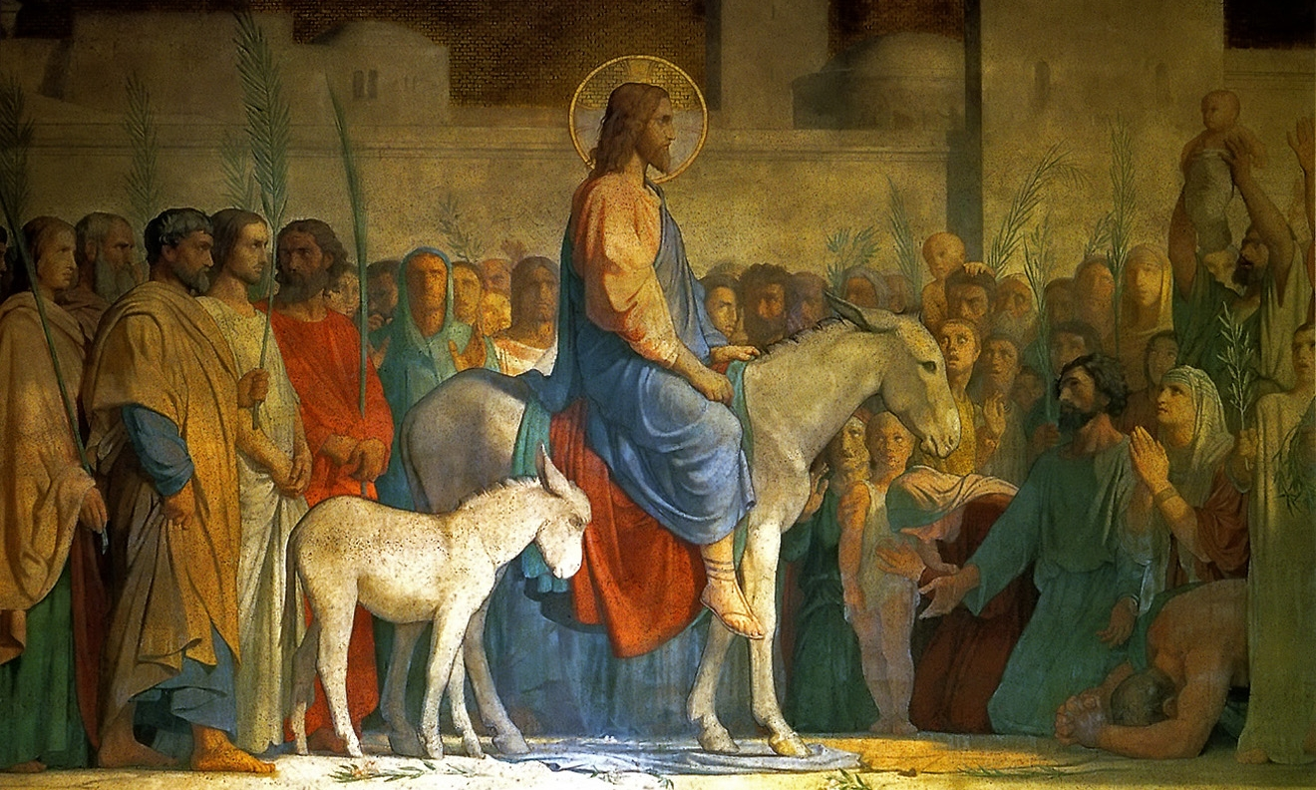

Slide 6
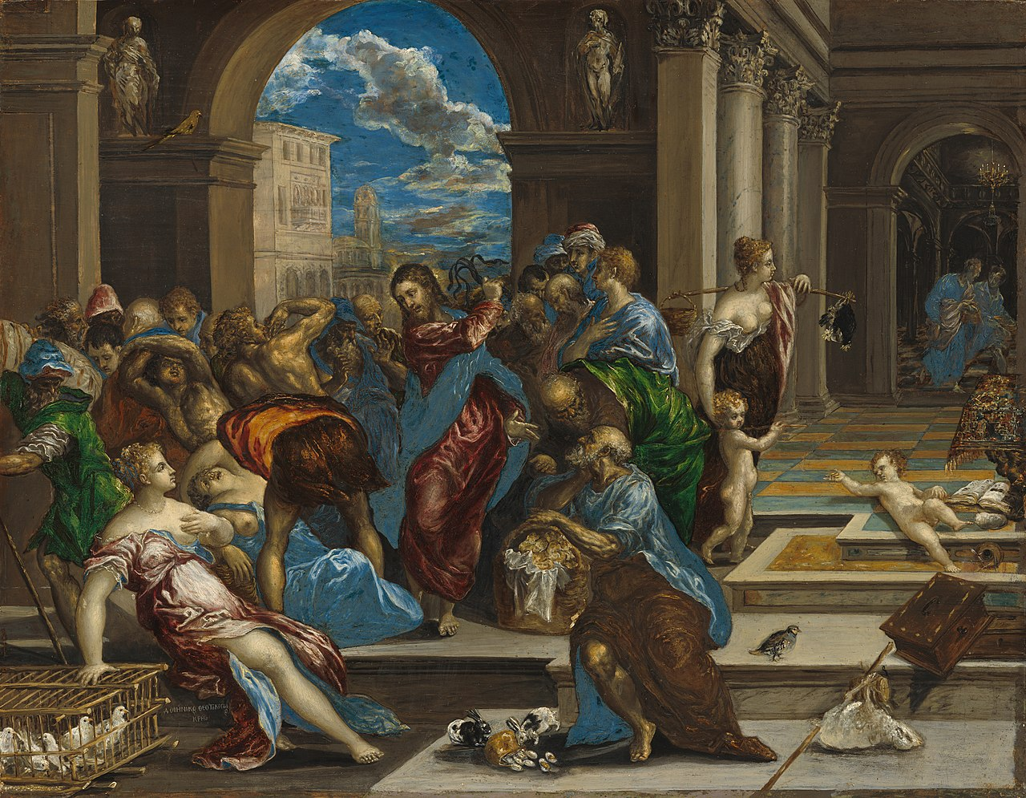

Slide 7
Thoughts?

Slide 9
Leaving your pride behind
P R A C T I C E

Slide 10
Regular repentance (μετάνοια)
P R A C T I C E

Slide 11
Living like your actions are the only way that people can know Christ
P R A C T I C E

Slide 12
P R A C T I C E what you
- Matthew 21.28-32 -
Preach

