Slide 1
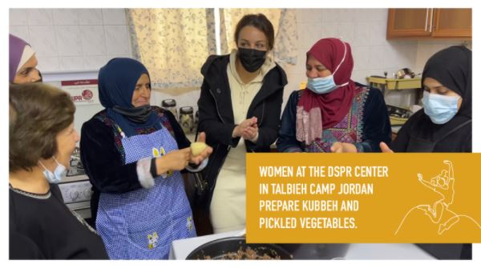
Report Back
Special Project
2020-22 Palestine
Notes:
Thank you for raising funds for the women and children in Palestine over the last two years with Christian World Service. It has been a difficult time for many people. Thank you for praying for the work we do together – especially for Syrian and Palestinian refugees and sharing the task of caring for people in need.
Over the last two years, the Special Project raised $26,785 for Palestine. Your donations mean more women can earn the extra income that helps them to do a little more than survive. In Jordan these mothers (above) are pickling beetroot, cauliflower, potatoes, kohlrabi and other vegetables with salt, a little sugar and water before preserving them. The women make bags and food items to sell at the market in Amman as well as attend classes on issues like gender.
The economic crisis in Lebanon affects most people. There are three hours of electricity a day except for the Palestinian camps where there is only one unless people can run their own generator. DSPR Lebanon has moved into smaller premises where they continue to support education programmes for all ages.
March 15 was the eleventh anniversary of the Syrian uprising that is recognised as the beginning of the conflict. Neighbouring countries are hosting 5.7 million refugees, many of whom want to return but it is not yet safe. Your gifts are giving them hope and community – thank you!

Slide 2
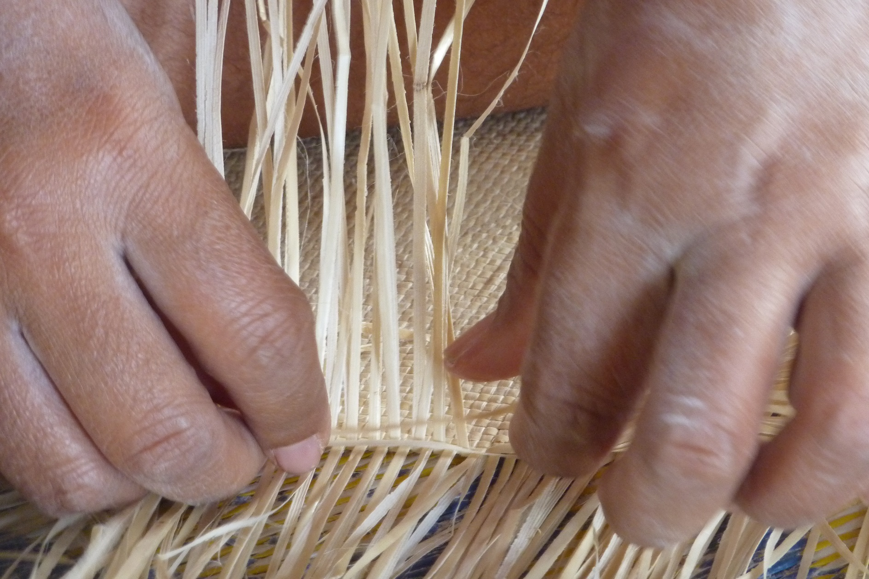
Promoting family well-being in covid times
2022
Notes:
The focus of this year’s Special Project is the Pacific. We are focusing on supporting family well-being.
During the Covid pandemic, life has become more difficult for many families, especially when their income falls. In Fiji, the tourism industry collapsed, cutting the Gross Domestic Product by 15.7% in 2020 alone. An industry that once employed 150,000 people directly and indirectly stopped quickly, leaving families dependent on outside help. Rural villages could not feed all of the returning workers and many urban workers were stuck with no land to make a garden. Often there was little warning of lockdown and people had no money to stock up on supplies, leaving them hungry and isolated.
Domestic and family violence increase with lockdowns and as community support becomes out of reach. Our partners the Social Empowerment and Education Programme (SEEP) are training women’s groups to monitor and assist where they can – so far this is working. Another partner the Pacific Conference of Churches is running training programmes for church leaders in order to protect people from harm.
Ask: Do you have family connection s to a special place in the Pacific? Do you know how they have managed during the pandemic? If so, you might like to share a story.

Slide 3
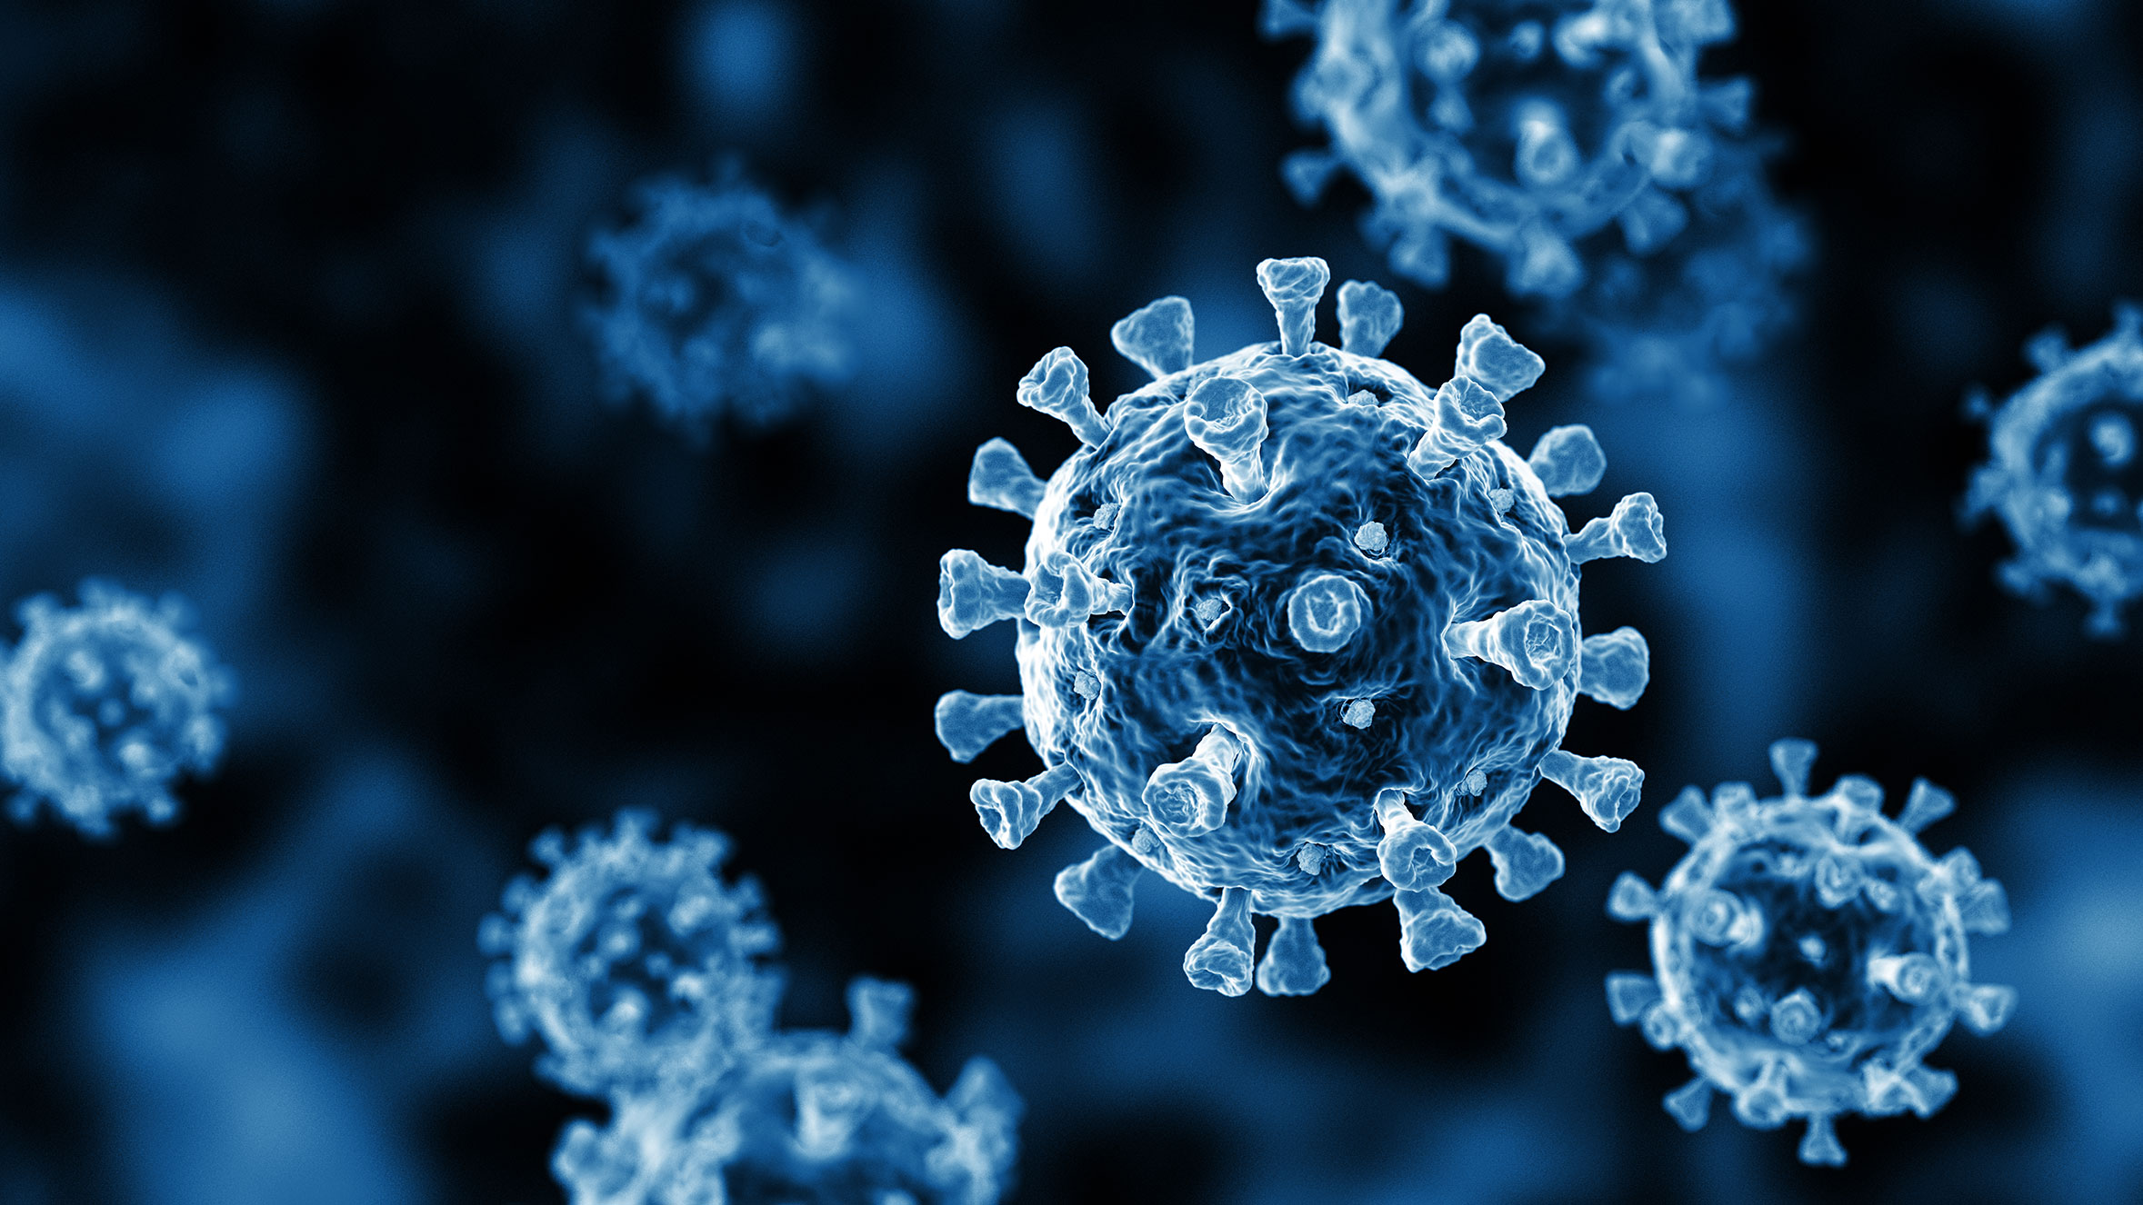
Notes:
Covid in the Pacific
16 countries have reported cases and deaths due to Covid. By mid-March, Fiji had lost the highest number of people to Covid – 834 followed by Maohi Nui (French Polynesia) where 645 have passed away.
You can check the most recent figures here: https://www.spc.int/updates/blog/2022/03/covid-19-pacific-community-updates
Across the Pacific families have lost jobs and income from remittances has fallen. Where they can, families have returned to traditional livelihoods but this has not always been possible. In places like Fiji lockdowns have happened quickly giving people little time to prepare. Health advice is not always available and sometimes people find it difficult to work out who to believe.
Ask: Over the last two years what ways has Covid-19 affected the communities you are part of? What have you found challenging? What has been good?

Slide 4
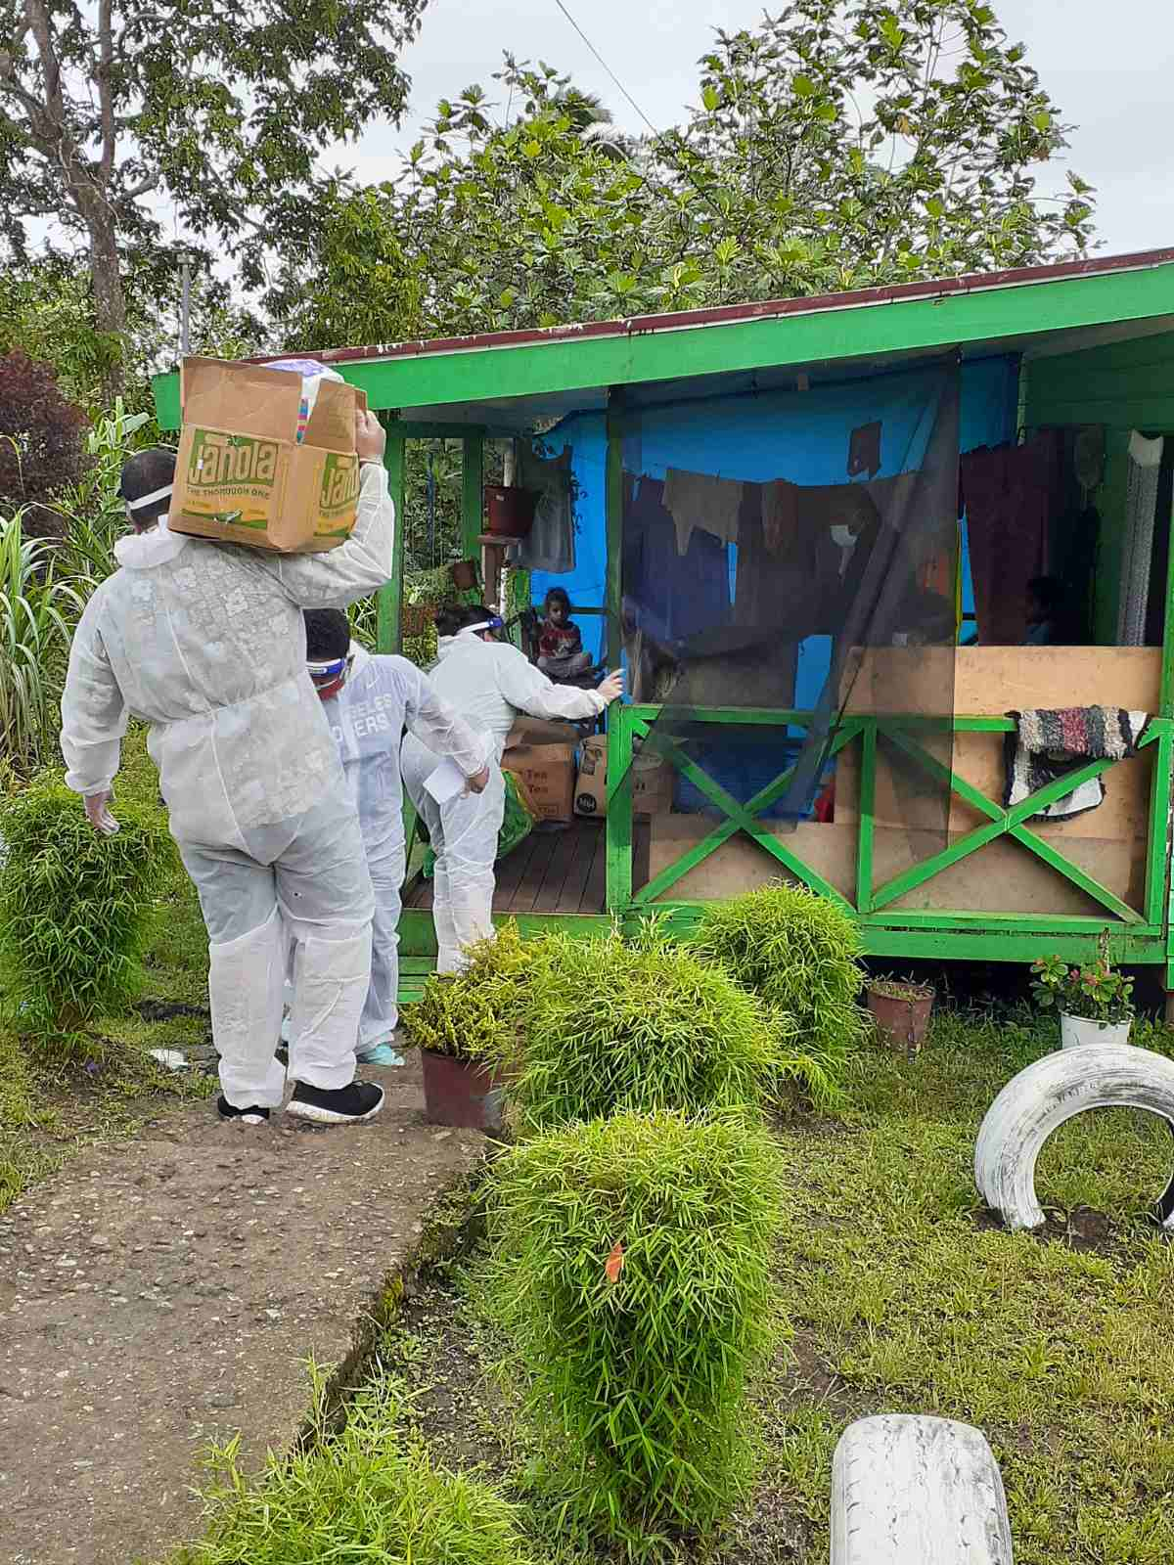
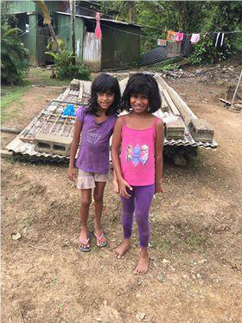
Notes:
Starting in Fiji
The Special Project is raising funds to continue the work of SEEP. SEEP is now working with 48 rural villages on development. Staff have kept in touch with them, often by phone, providing the latest health information on Covid and other non-communicable diseases like leptospirosis. In addition, they have raised awareness about domestic violence. At the time of writing, no one has had Covid or leptospirosis, and there have been zero incidents of domestic violence despite all that has happened.
SEEP has distributed emergency food rations and hygiene kits to some families stuck at home with nothing. SEEP began with the most vulnerable senior citizens, single mothers and young people. When they can, staff purchase food from the rural villages where they work, promoting the ‘circular economy’ which keeps money in local hands. The government has provided some support like bus fares and food vouchers but it has not always been enough.

Slide 5
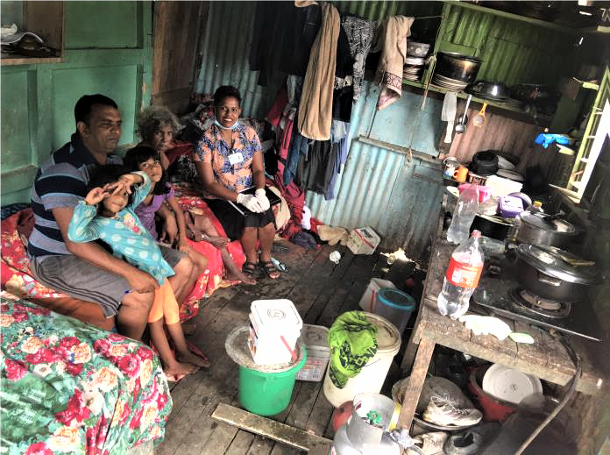
Notes:
More recently, SEEP has begun work on helping these families to establish backyard gardens. Not all families have access to land but if they can grow at least some of the food they need, their well-being will improve. They need tools, seeds and plants to make things grow.
SEEP is running a new Livelihood Hand-up Project to set up small cooperatives in 15 rural villages and informal settlements. It will train five women who are struggling more than most, to set up and run a community canteen. The canteen will supply basic food items and it is hoped the canteens will become self-funding.
According to the most recent data from the Asian Development Bank, 29.9% of Fijians lived below the poverty line.
People are being vaccinated but the economy will take much longer to recover.

Slide 6
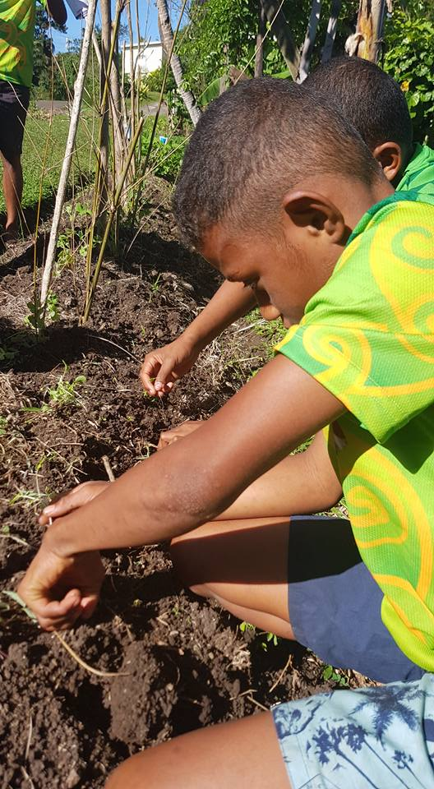
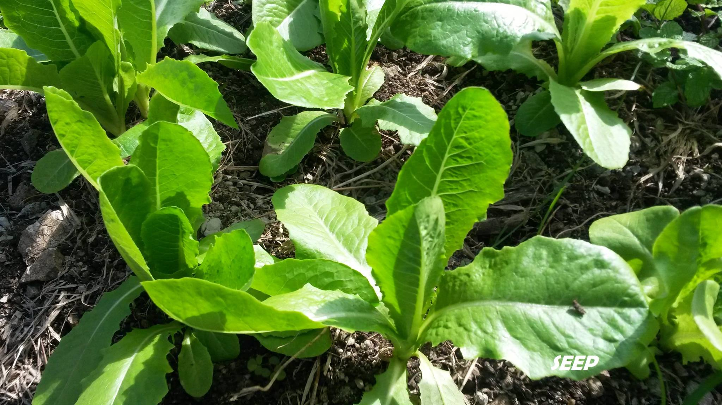
Notes:
Another way SEEP is assisting the most vulnerable people is through Go Organic, its gardening programme. They promote family well-being by passing on gardening skills and the need for healthy eating to new generations. If families can grow at least some of their own food, they have more security. Gardening can relieve tension and foster family and community life.

Slide 7
Notes:
The eruption of Hunga Tonga-Hunga Ha’apai volcano in January was a sudden reminder of how vulnerable the Pacific is to natural disasters. Tongans have shown great strength in their response. Unfortunately, Covid has now entered the country and first deaths have been recorded.
The recovery from the eruption will be slower and the added health pressures from Covid are a great worry. The Special Project may also assist families in Samoa, Tonga, the Solomon Islands or other Pacific nations struggling to deal with the effects of Covid.

Slide 8
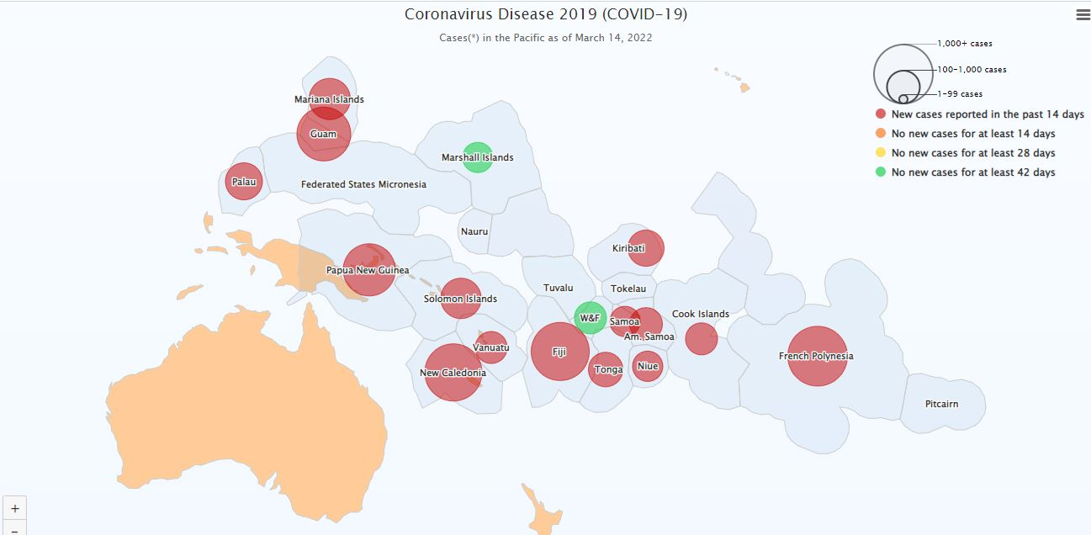
Notes:
Here is a map from the Pacific Community showing the spread of Covid in the Pacific on a specific day. You may like to replace it with the most recent version. You can download the most recent version here: https://www.spc.int/updates/blog/2022/03/covid-19-pacific-community-updates
There is a statistical table reporting on each country underneath the map on the page.
If you hover over each country you can find more information.

Slide 9
Notes:
Reweaving the Ecological Mat is a new project of the Pacific Conference of Churches and the Pacific Theological College. Pacific leaders want to rewrite the narrative, building on indigenous knowledge and understandings of well-being that have been at the heart of Pacific communities. They say that the dominant economic model is built on exploitation and extraction. As indigenous people they carry the responsibility to protect the land, forest and sea. Covid and climate change are causing harm to the environment and to the community.
For them the Covid pandemic shows the need to reset the story about life in the Pacific. They are advocating a new model that will sustain the land, the ocean and people for the future.
Iemima (pictured above), originally from Samoa, works as an Ecumenical Enabler with the Pacific Conference of Churches. Last year she attended the United Nations Climate Change talks – COP 26 (Council of Parties) – in Glasgow. Standing alongside a handful of Pacific representatives , she advocated for climate justice.
Ask: Thinking about the Pacific Ocean –sometimes called the blue continent – what could you do to protect our shared future?

Slide 10
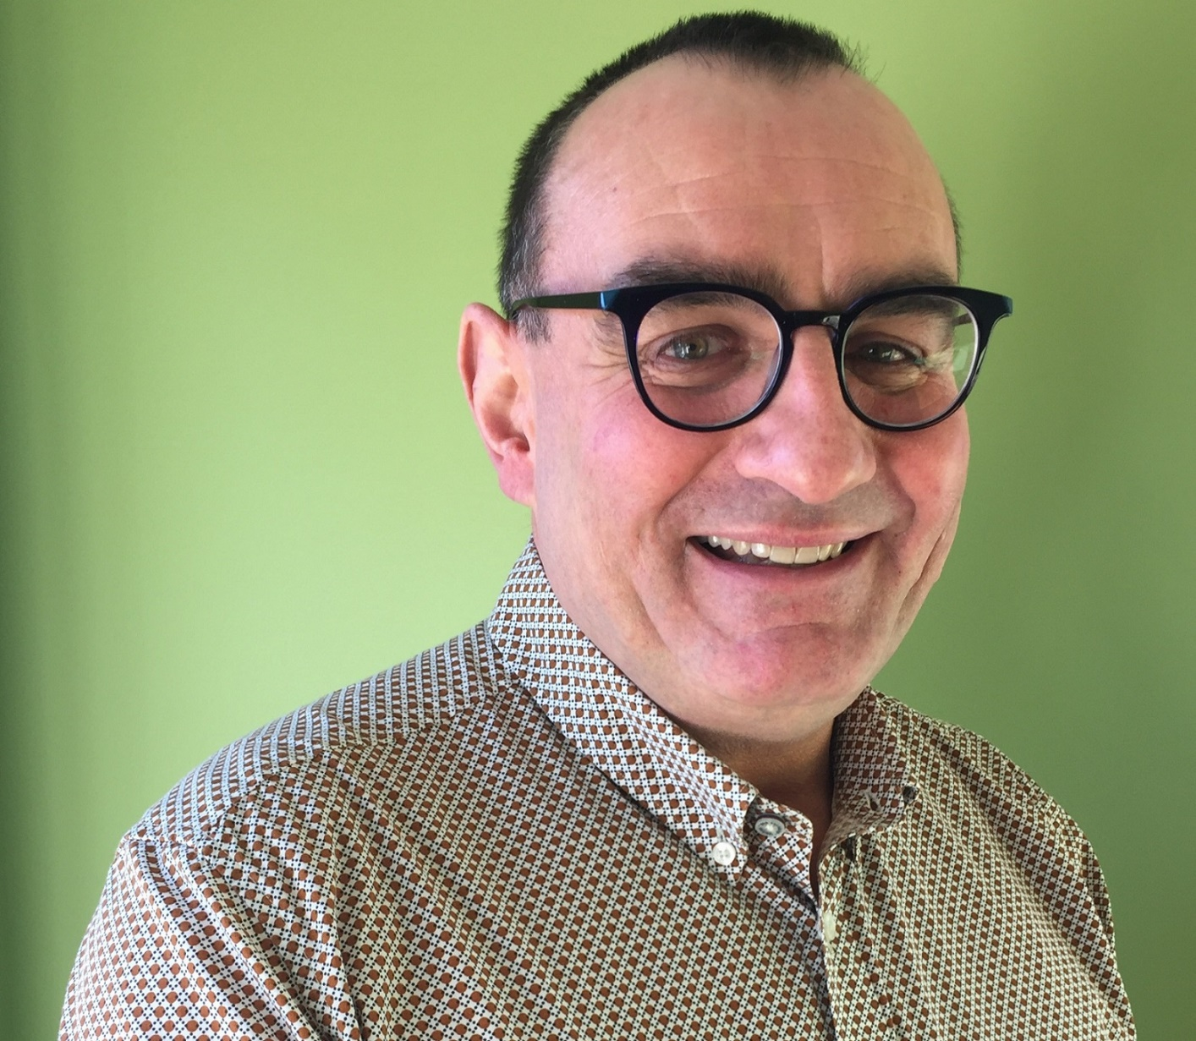
Thank you for supporting the Special Project
2022
Notes:
Murray Overton started as the National Director last year. He looks forward to meeting you in the months and years ahead. Please pass on his message to your group:
“Thank you for supporting the work of Christian World Service each year in the Special Project. We truly appreciate your interest in the work taking place overseas, and the wonderful way you work to assist others through the funds you raise.
This year your support will make such a positive difference to individuals, families and communities in the Pacific who are struggling with the affects of Covid in particular. The economic impact, felt by many, is an ongoing challenge.
Thank you for partnering with us and for your ongoing interest in helping our family and neighbours in the Pacific.”
Thank you from all of us at Christian World Service.

