Slide 1


More “Good News” Stories

Slide 2
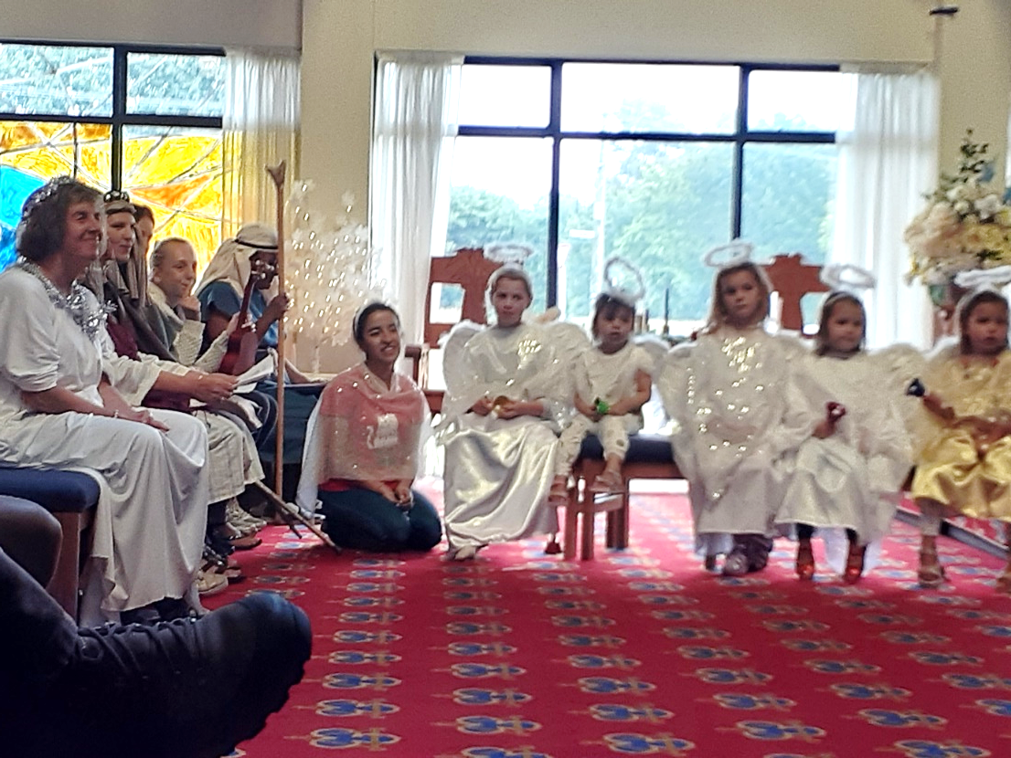
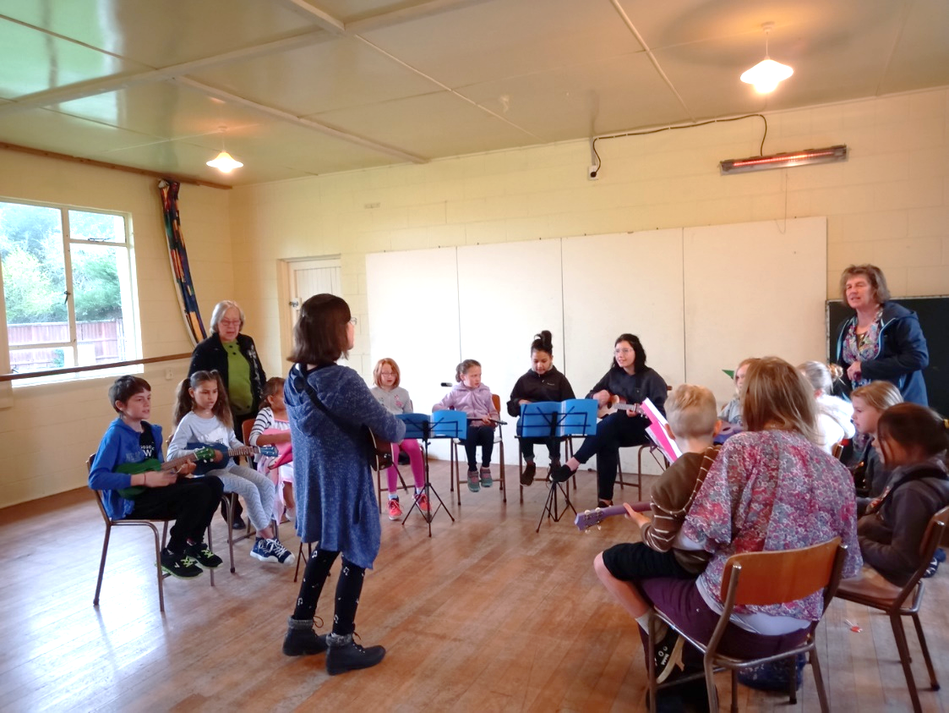
Malvern Co-Operating Parish, Darfield
Last year the Sunday School Children’s Praise Orchestra of the Malvern Co-Operating Church received grant funding from “Let the Children Live” to purchase some new instruments for their orchestra.
Early in the New Year we received an email and photographs with details of their special Christmas Eve production where they sang and played their new musical instruments. The Christmas Eve service was packed and included a special item on the ukuleles.

Slide 3
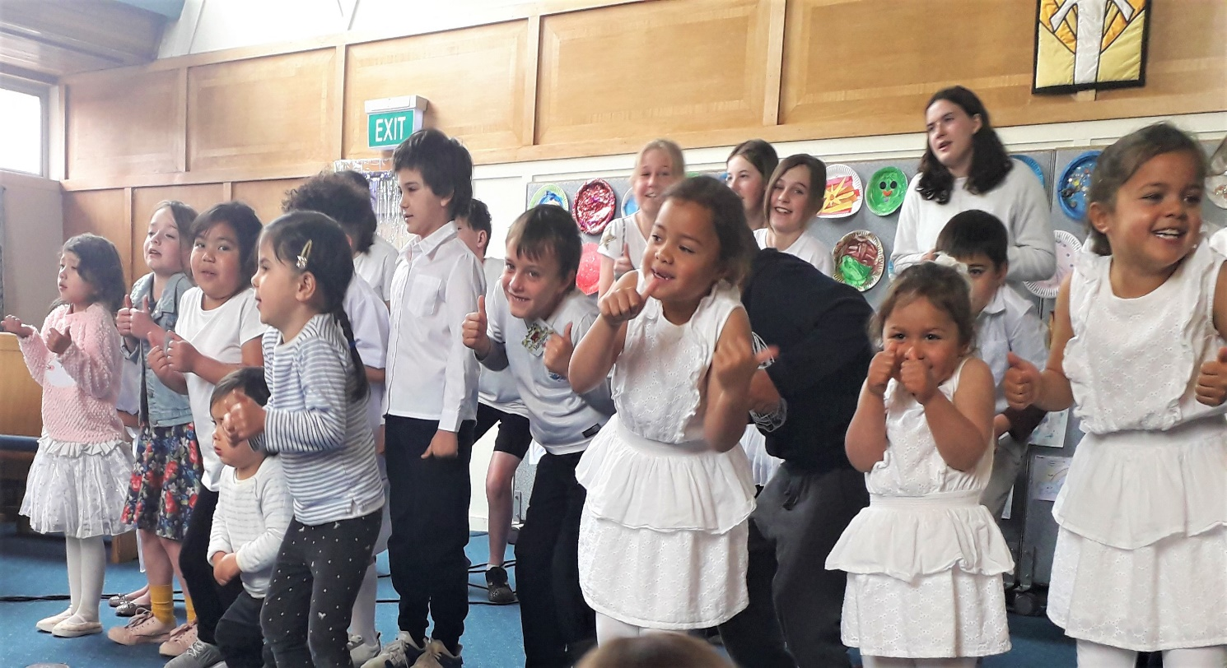
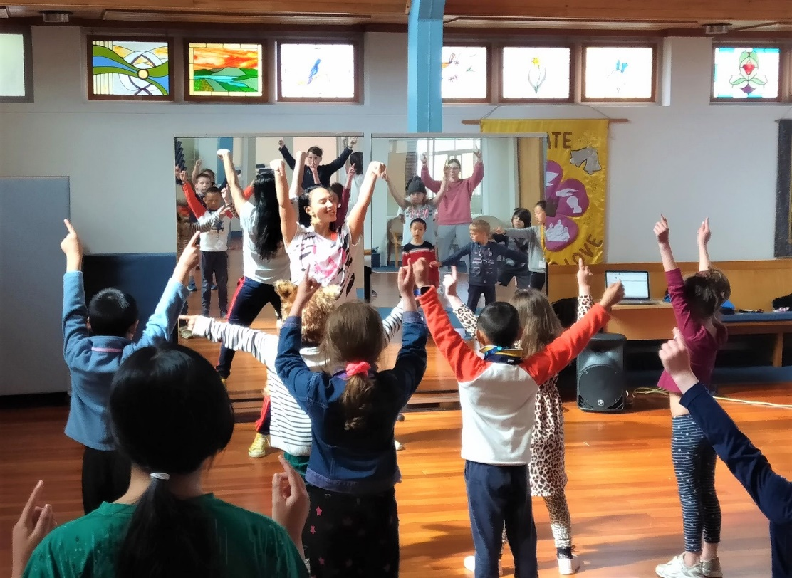
Holiday Fun enhanced at St Ninian’s Karori
St Ninian’s Karori received a grant from the “Let the Children Live” fund in September 2020. The grant enabled them to increase the activities on offer at the October programme with fresh art and craft supplies and gift bags for each child after the Sunday service. The grant was also a big help with the costs of nutritional morning teas and lunches for six days as the October programme catered for over 30 children.
The theme for the October programme was Lotu Tamiti, or White Sunday which could not be more fitting as Lotu Tamiti is a special day on the Christian calendar in many Pacific nations – a day for celebrating children.

Slide 4
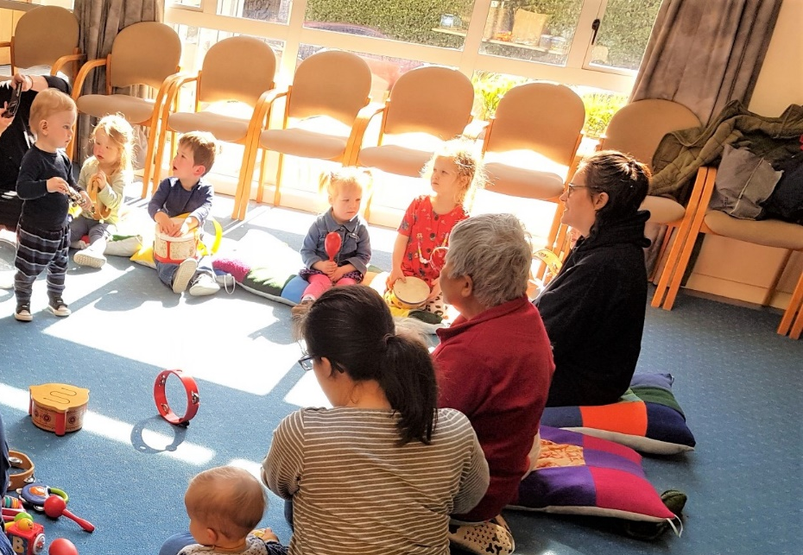
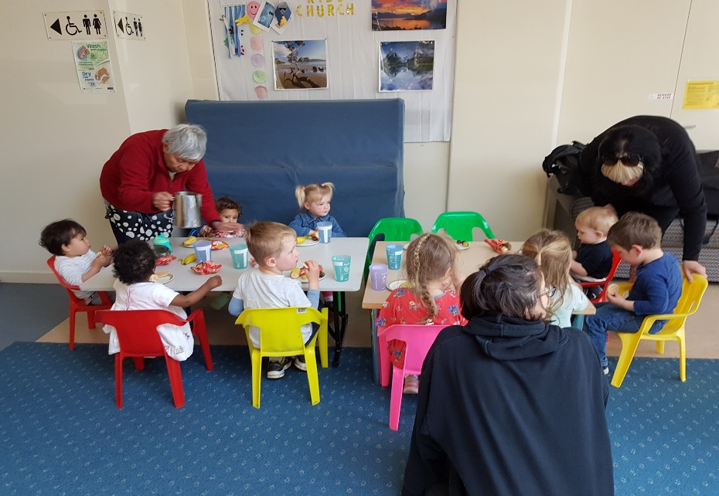
Footprints – Preschool programme
St Ninian’s started a pre-schoolers’ music and movement programme called ‘Footprints’ in September 2020. It has quickly grown to now have 11 families in regular attendance. The families love the rich sense of community and care, development and learnings that Footprints provides. Children learn through music, dancing, reading and free play. Footprints reflects St Ninian’s Christian values of strong community relationship enhancement and putting whanau first.
With the extra funding their team of dedicated volunteers were able to purchase some musical instruments for the tamariki and provided morning tea for the children and caregivers in attendance.

Slide 5
Wellington Methodist Parish
The Taranaki Street Church in the Wellington Methodist Parish has been having seismic strengthening which has resulted in the church being closed from November 2019 until April 2021. Normal activities are being held in the church hall. The children suggested they should paint a mural to make the entrance more welcoming as they missed their friends from the combined services. They were successful in their application for “Let the Children Live” funding and went to work painting the mural on their wall.

Slide 6
At the beginning of December their wall was finished and they were very pleased to hold their first combined service since January 2020. What started out as a blank canvas became a very vibrant mural of which they are all proud!

Slide 7
Auckland Manukau Tongan
Methodist

Slide 8
The Auckland Manukau Tongan Methodist Parish has been broadcasting a weekly programme called “Taulama Fakakosipeli” (literally means ‘Watchman of the Gospel’) for the past 25 years from the Radio Station 104.6 FM – an access community radio located at Mt Albert.
This is a 50-minute weekly program which is held every Thursday afternoon
from 3.55 to 4.45 pm.

Slide 9
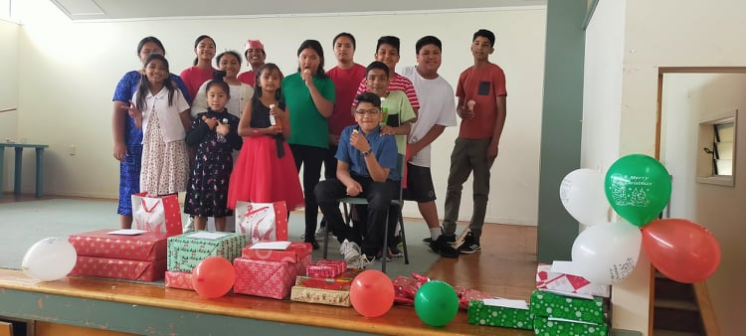
On 13th December 2020 the Papatoetoe Wesley Methodist Sunday School celebrated their Anniversary. The children enjoyed the programme and were very excited to play their part in church by leading the Christmas service. It was a great success seeing both children and parents participating in the celebration of the Sunday School anniversary.
Papatoetoe Wesley Methodist Church Sunday School

Slide 10
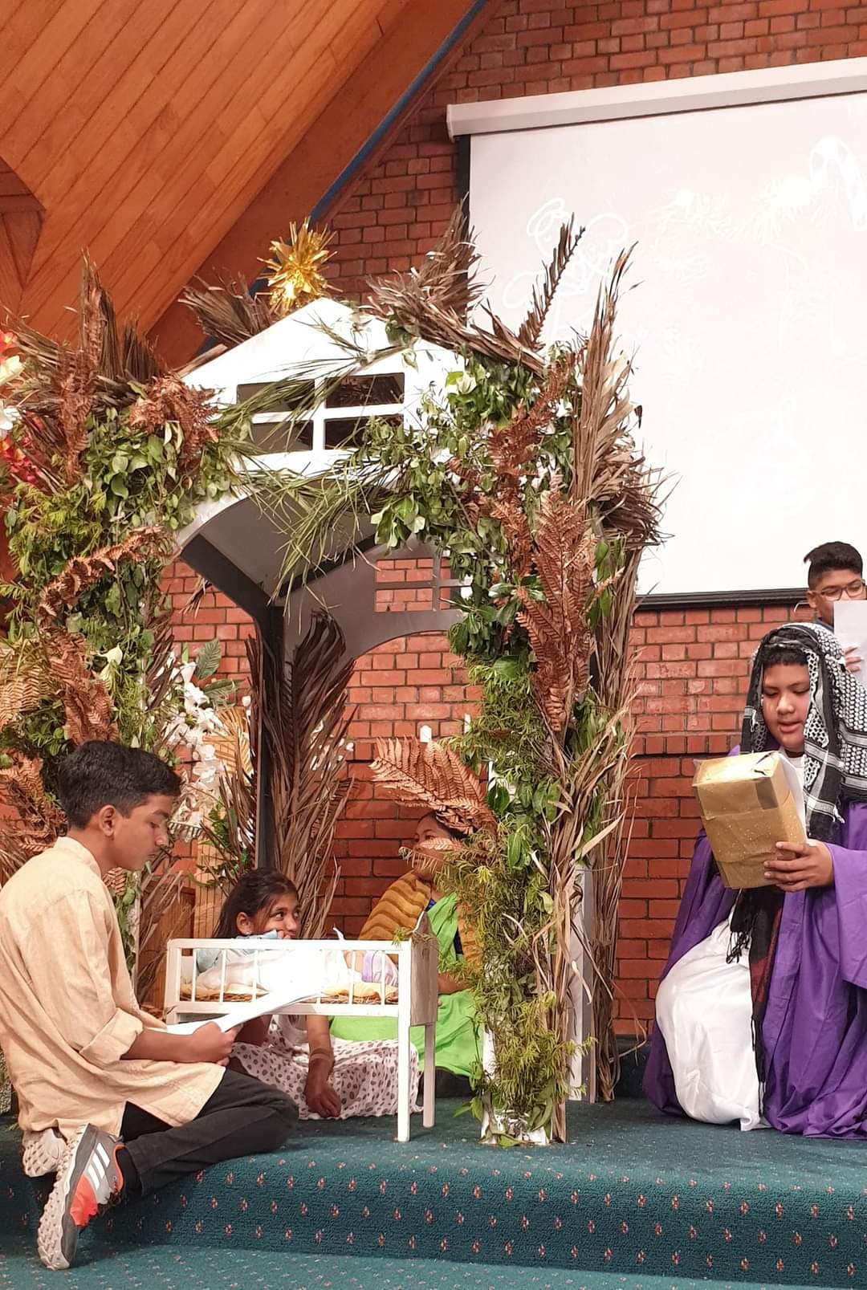
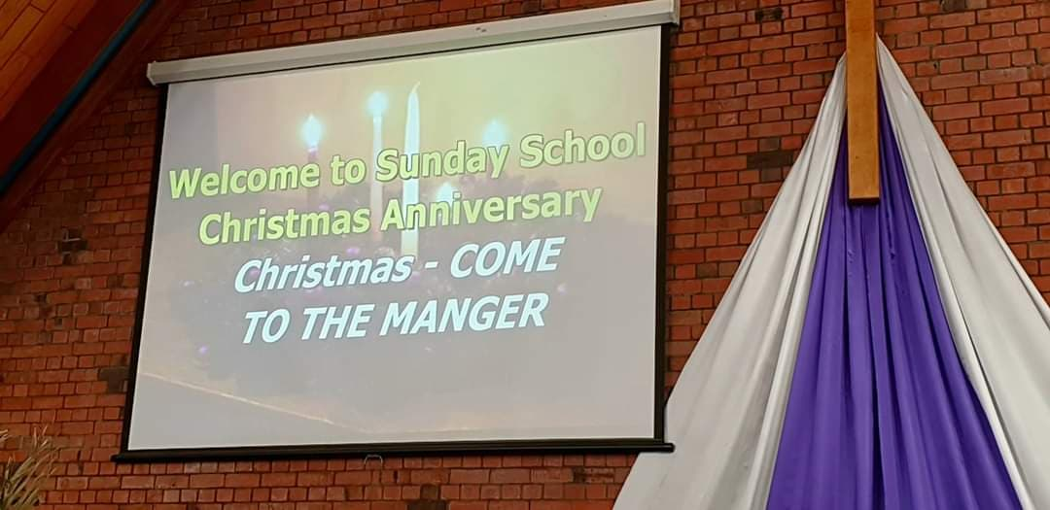
The Sunday School children prepared a small drama called “Come to the Manger” where they were dressed up according to their character. A manger was built to support the presentation and the efforts were very much appreciated.
During the Sunday School Anniversary service, children also prepared a few dance performances on Christmas songs.

Slide 11
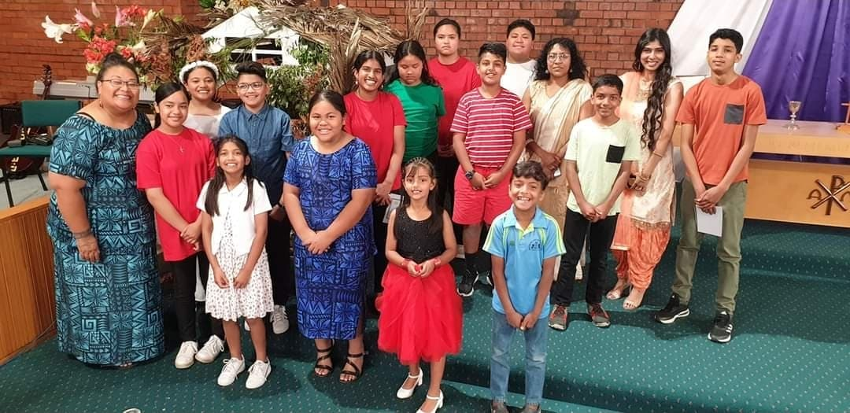

Slide 12

Closing dates for 2022 applications:
3rd May, 2nd August & 1st November
Don’t delay and post your application
today to:
‘Let the Children Live’ – Mission Resourcing,
Private Bag 11-903, Ellerslie, Auckland 1542
or email: admin@missionresourcing.org.nz

